Slide 1

Reliability of the Bible
A Book Like No Other
Joshua Witt
Notes:
When you treat the Bible like any other historical book, rather than a fairy tale, it becomes abundantly clear: it is neither.

Slide 2
What does Scripture claim about itself?
“The grass withers, the flower fades, but the word of our God will stand forever.” Isaiah 40:8
Permanent
God-breathed
Accurate
Matthew 24:35
2 Timothy 3:16–17
John 14:26
“Heaven and earth will pass away, but my words will not pass away.”
“All Scripture is breathed out by God and profitable for teaching, for reproof, for correction, and for training in righteousness, that the man of God may be complete, equipped for every good work.”
“But the Helper, the Holy Spirit, whom the Father will send in my name, he will teach you all things and bring to your remembrance all that I have said to you.”
Paul’s letters are Scripture too: Peter says some things in Paul’s letters are hard to understand, “which the ignorant and unstable twist to their own destruction, as they do the other Scriptures.” 2 Peter 3:15–16
Scripture claims divine origin, permanence, and Spirit-enabled accuracy in recording Jesus’ words. The rest of this talk tests whether the record bears that out.
Scripture quotations are from the ESV® Bible (The Holy Bible, English Standard Version®), © 2001 by Crossway. Used by permission. All rights reserved.
Notes:
2 Timothy 3:16 to 17 (not 1 Timothy). Matthew 24:35. John 14:26. Isaiah 40:8. Paul's letters as Scripture: 2 Peter 3:15 to 16 (ESV): 'just as our beloved brother Paul also wrote to you according to the wisdom given him, as he does in all his letters when he speaks in them of these matters. There are some things in them that are hard to understand, which the ignorant and unstable twist to their own destruction, as they do the other Scriptures.' Peter places Paul's letters alongside 'the other Scriptures', showing they were already treated as Scripture within the apostolic generation. For Q&A: many critical scholars doubt Peter wrote 2 Peter and date it later; on traditional authorship it was written in the mid-60s AD. Scripture quotations are from the ESV Bible (The Holy Bible, English Standard Version), copyright 2001 by Crossway. Used by permission. All rights reserved. This slide states what the Bible claims about itself; the following sections test those claims against the manuscript and historical evidence.

Slide 3
Even Peter found Paul hard to follow
“There are some things in them that are hard to understand…” 2 Peter 3:16, on Paul’s letters
“Because of the angels”?
Baptized for the dead?
1 Corinthians 11:10
1 Corinthians 15:29
“That is why a wife ought to have a symbol of authority on her head, because of the angels.”
“Otherwise, what do people mean by being baptized on behalf of the dead? If the dead are not raised at all, why are people baptized on their behalf?”
Head coverings, fine. But what do angels have to do with it? Paul doesn’t say, and scholars still debate it.
Mentioned once, never explained. One study catalogued about 40 interpretations.
Hard to understand is not the same as unreliable: Peter still ranks Paul’s letters with “the other Scriptures.”
2 Peter 3:16; 1 Corinthians 11:10; 15:29 (ESV). Interpretations: B. M. Foschini, “Those Who Are Baptized for the Dead,” Catholic Biblical Quarterly 12–13 (1950–51).
Notes:
A light moment: even the apostle Peter admitted Paul could be hard to understand. 2 Peter 3:15 to 16 (ESV): 'just as our beloved brother Paul also wrote to you according to the wisdom given him, as he does in all his letters when he speaks in them of these matters. There are some things in them that are hard to understand, which the ignorant and unstable twist to their own destruction, as they do the other Scriptures.' Example 1, 1 Corinthians 11:10 (ESV): 'That is why a wife ought to have a symbol of authority on her head, because of the angels.' Paul never explains the angels. Common suggestions: angels are present in worship and observe its order (compare 1 Cor 4:9; Hebrews 1:14); a reference to the fallen 'sons of God' of Genesis 6; or angels as guardians of creation order. None is certain. Example 2, 1 Corinthians 15:29 (ESV): 'Otherwise, what do people mean by being baptized on behalf of the dead? If the dead are not raised at all, why are people baptized on their behalf?' This is the only mention of the practice anywhere in the Bible. B. M. Foschini's study in the Catholic Biblical Quarterly (1950 to 1951) catalogued about 40 interpretations; some later commentaries say as many as 200. Paul's point is clear even if the practice is not: the Corinthians' own behavior assumed the dead will rise. He does not endorse the practice, and he says 'they', not 'we'. For Q&A: the Latter-day Saints base proxy baptism on this verse; historic Christianity has not practiced it. The takeaway: difficult passages are honest marks of real letters to real churches, not signs of an unreliable text, and Peter, who found them hard, still counted them as Scripture.

Slide 4
Unashamed, and ready to give a reason
Unashamed
Ready
Romans 1:16
1 Peter 3:15
“For I am not ashamed of the gospel, for it is the power of God for salvation to everyone who believes, to the Jew first and also to the Greek.”
“But in your hearts honor Christ the Lord as holy, always being prepared to make a defense to anyone who asks you for a reason for the hope that is in you; yet do it with gentleness and respect.”
Believe
“If you confess with your mouth that Jesus is Lord and believe in your heart that God raised him from the dead, you will be saved.”
Romans 10:9
Romans 1:16; 1 Peter 3:15; Romans 10:9 (ESV). Scripture quotations are from the ESV® Bible, © 2001 by Crossway. Used by permission. All rights reserved.
Notes:
Romans 1:16 (ESV): 'For I am not ashamed of the gospel, for it is the power of God for salvation to everyone who believes, to the Jew first and also to the Greek.' 1 Peter 3:15 (ESV): 'but in your hearts honor Christ the Lord as holy, always being prepared to make a defense to anyone who asks you for a reason for the hope that is in you; yet do it with gentleness and respect,' (the sentence continues into verse 16: 'having a good conscience, so that, when you are slandered, those who revile your good behavior in Christ may be put to shame'). The word translated 'defense' is the Greek apologia, a reasoned legal defense, from which we get 'apologetics'. Paul uses the same word of his own defense in Acts 22:1 and Philippians 1:7, 16. Romans 10:9 (ESV): 'because, if you confess with your mouth that Jesus is Lord and believe in your heart that God raised him from the dead, you will be saved.' Verse 10: 'For with the heart one believes and is justified, and with the mouth one confesses and is saved.' Note that the belief Paul names is that God raised Jesus from the dead, which is exactly the claim the resurrection section of this talk examines. Framing for the talk: we are not embarrassed to examine the evidence, and we present it with gentleness and respect.

Slide 5
The top 5 best sellers, combined
ALL-TIME BEST SELLERS (COPIES SOLD)
The Bible: ~6 billion printed (est.)
A Tale of Two Cities
200M
Harry Potter & the Philosopher’s Stone
120M
Top 5 combined: 620 million
And Then There Were None
100M
The Hobbit
100M
≈ 10%
Alice’s Adventures in Wonderland
100M
Combined
620M
Even all five together come to only about a tenth of the Bibles printed.
Each square = 600 million copies
Notes:
Top five all-time best sellers: A Tale of Two Cities 200M, Harry Potter 120M, And Then There Were None 100M, The Hobbit 100M, Alice's Adventures in Wonderland 100M. Together, 620 million copies sold. The Bible: an estimated 6 billion copies printed (printed rather than sold, since many were given away). The top five combined are only about 10% of that.

Slide 6
A book for the whole world
8 Billion
6 Billion
80 Million
4,190
people on earth
Bibles printed (est.)
Bibles printed every year
languages with Scripture
COPIES SOLD IN THE US, 2024
Bibles sold
17M
#1 new book, 2024
1.5M (The Women, by Kristin Hannah)
Americans bought over 11 times as many Bibles as copies of 2024’s best-selling book.
Sources: Guinness World Records (Bibles printed); Circana BookScan via Publishers Weekly (2024 US print sales, both bars); SIL ProgressBible (languages, Oct 2026).
Notes:
Sales comparison: Circana BookScan, which tracks US retail print book sales, recorded a record 17 million Bibles sold in 2024, up 22% on 2023 and up from about 5 million in 2015 (Publishers Weekly, Jim Milliot, 14 March 2025). The best-selling new book of 2024 on the same tracker was Kristin Hannah's The Women, at about 1.5 million print copies. Both bars use the same tracker, market and year. Languages: SIL International's ProgressBible report (1 October 2026) counts 812 languages with the full Bible, 1,863 more with the New Testament and 1,515 more with portions: at least one book of the Bible in 4,190 of the world's 7,394 living languages. Wycliffe Global Alliance (2025) reports that more than 99% of the world's population now has access to at least some Scripture in a language they use.

Slide 7
The uniqueness of the Bible
Its continuity and diversity are remarkable.
3 languages
3 continents
40+ authors
Hebrew, Aramaic and Greek, rooted in real cultures and history
Its authors came from Africa, Asia and Europe
With diverse backgrounds and perspectives
66 books
1,500 years
1 story
39 Old Testament and 27 New Testament, in many genres
Written over some fifteen centuries and many generations
Creation, fall and redemption, told by many authors

Slide 8
“Unhitch” the Old Testament?
THE CLAIM
WHAT THE EARLY CHURCH ACTUALLY DID
“Peter, James, Paul elected to unhitch the Christian faith from their Jewish scriptures, and my friends, we must as well.”
Luke 24:27 · Jesus
“Beginning with Moses and all the Prophets, he interpreted to them in all the Scriptures the things concerning himself.”
“When the Church launched, the foundation of the faith of the early Christians was not a book (they didn’t have one) … it wasn’t the Bible (there wasn’t one), and it wasn’t the Old Testament.”
1 Corinthians 15:3–4 · the earliest creed
Christ died and was raised “in accordance with the Scriptures.”
Acts 15:15 · the very council Stanley cites
“With this the words of the prophets agree, just as it is written” (then quoting Amos 9).
Andy Stanley, North Point Community Church, “Aftermath” series, part 3 (2018)
Acts 17:11 · the Bereans
To be fair: he also called the Jewish scriptures “divinely inspired,” and said critics missed his context (Acts 15: Gentiles and the law of Moses).
They checked Paul by “examining the Scriptures daily to see if these things were so.”
They had no bound Bible yet, but they had Scripture: the Old Testament, read as pointing to Christ.
Stanley quotes as reported by M. Gryboski, The Christian Post (9 May 2018), and E. Hall, Crosswalk.com (11 May 2018). Scripture: ESV.
Notes:
Andy Stanley (son of Charles Stanley), senior pastor of North Point Community Church, Atlanta, preached this in part 3 of his 2018 sermon series 'Aftermath'. Quotes as reported by Michael Gryboski, 'Christians Must Unhitch Old Testament From Their Faith, Says Andy Stanley', The Christian Post, 9 May 2018: 'Peter, James, Paul elected to unhitch the Christian faith from their Jewish scriptures, and my friends, we must as well.' Also: '[first-century] church leaders unhitched the church from the worldview, value system, and regulations of the Jewish scriptures', and 'The Bible did not create Christianity. The resurrection of Jesus created and launched Christianity.' The 'they didn't have one' quote is as reported by Emily Hall, '3 Things Andy Stanley Got Wrong about the Old Testament', Crosswalk.com, 11 May 2018: 'When the Church launched, the foundation of the faith of the early Christians was not a book (they didn't have one), it wasn't the Bible (there wasn't one), and it wasn't the Old Testament because that didn't tell the story of Jesus.' No official transcript was found; if possible, check the wording against the North Point sermon video before presenting. Fairness: in the same sermon Stanley said the Jewish scriptures are 'divinely inspired' and 'an important backstory', and his point was about Gentile believers and the law of Moses (Acts 15). In a May 2018 Relevant Magazine interview he said some people 'did not understand the point I was making'. Critics such as Kevin DeYoung and Wesley Hill said the sermon echoed Marcion, the second-century teacher who rejected the Old Testament. Where he is right: the early church had no bound Bible and no finished New Testament. Response: they did have Scripture, the Old Testament, and used it constantly. Jesus taught from it about himself (Luke 24:27). The earliest creed says Christ died and was raised 'in accordance with the Scriptures' (1 Cor 15:3 to 4). At the Jerusalem council Stanley cites, James settles the question by quoting the prophets: 'with this the words of the prophets agree, just as it is written' (Acts 15:15 to 18, quoting Amos 9:11 to 12). The Bereans tested Paul against the Scriptures (Acts 17:11). Paul tells Timothy his childhood 'sacred writings' (the Old Testament) 'are able to make you wise for salvation through faith in Christ Jesus' (2 Tim 3:15), right before 'All Scripture is breathed out by God' (3:16, slide 2).

Slide 9

63,779 cross-references in 31,102 verses
Visualization: Chris Harrison and Christoph Römhild, “Bible Cross-References” (2007), chrisharrison.net
Notes:
Visualization by Chris Harrison (then a PhD student at Carnegie Mellon University) with Pastor Christoph Römhild, 2007: https://www.chrisharrison.net/index.php/Visualizations/BibleViz. The bar chart along the bottom shows every chapter of the Bible, Genesis 1 at far left, each bar's length the chapter's verse count. Each of the 63,779 arcs is one cross-reference between two chapters, coloured by the distance between them, so the rainbow shows how the whole Bible refers to itself. The cross-reference data was compiled by Römhild from the King James Bible, which has 31,102 verses. The image is copyrighted; Harrison offers it free for personal use and the higher-resolution file for non-commercial use.

Slide 10
The minimal facts
Gary Habermas surveyed 1,400+ scholarly publications on the resurrection (1975–2005), later 3,400+, across the whole critical spectrum. These facts are granted by most of them:
1
Jesus died by crucifixion
Virtually all scholars. Crossan: “as sure as anything historical can ever be”
2
The disciples sincerely believed the risen Jesus appeared to them
Virtually unanimous. Lüdemann: “historically certain”
3
Paul, the church’s persecutor, converted after a perceived appearance
Virtually all; rests on Paul’s own letters (1 Cor 15:8; Gal 1:13–16)
4
James, Jesus’ skeptical brother, converted after a perceived appearance
A large majority of the scholars who address it
+1
The empty tomb
About 75% of scholars writing on it (roughly 3 to 1)
Habermas, “Resurrection Research from 1975 to the Present,” JSHJ 3.2 (2005): 135–53; Habermas & Licona, The Case for the Resurrection of Jesus (2004)
Notes:
The 'minimal facts' approach of Gary Habermas and Michael Licona uses only facts that are well evidenced and granted by the vast majority of scholars, including skeptics. Habermas catalogued more than 1,400 scholarly publications on the resurrection from 1975 to 2005, later more than 3,400 (Habermas, 'Resurrection Research from 1975 to the Present: What Are Critical Scholars Saying?', Journal for the Study of the Historical Jesus 3.2, 2005, 135 to 53). 1. Crucifixion: attested by all four Gospels plus Josephus, Tacitus, Lucian and the Talmud; John Dominic Crossan: 'That he was crucified is as sure as anything historical can ever be' (Jesus: A Revolutionary Biography, 1994, 145). 2. The disciples' experiences: Lüdemann calls them 'historically certain' (What Really Happened to Jesus, 1995, 80). 3. Paul: 1 Corinthians 15:8; Galatians 1:13 to 16; Philippians 3:6. 4. James: Habermas and Licona, 67 to 69. 5. The empty tomb: about 75% of scholars writing on the subject accept it (Habermas 2005, 140 to 41), hence its '4 + 1' status. Only the empty-tomb figure is an exact percentage; for the others Habermas says 'virtually all' or 'nearly unanimous', so do not quote percentages for them. Updated treatment: Habermas, On the Resurrection, vol. 1: Evidences (B&H Academic, 2024).

Slide 11
What even skeptics grant
Gerd Lüdemann
Paula Fredriksen
Atheist New Testament scholar
Jewish historian, Boston University
“It may be taken as historically certain that Peter and the disciples had experiences after Jesus’ death in which Jesus appeared to them as the risen Christ.”
The disciples’ conviction that they had seen the risen Christ is “historical bedrock, facts known past doubting.”
What Really Happened to Jesus (1995), 80
Jesus of Nazareth, King of the Jews (1999), 264
Agreed: the disciples sincerely believed they saw Jesus alive.
Disputed: the cause. Skeptics say visions or hallucinations, not a real resurrection.
Habermas & Licona, The Case for the Resurrection of Jesus (2004), 49–50
Notes:
Gerd Lüdemann, with Alf Özen, What Really Happened to Jesus: A Historical Approach to the Resurrection, trans. John Bowden (Westminster John Knox, 1995), 80: 'It may be taken as historically certain that Peter and the disciples had experiences after Jesus' death in which Jesus appeared to them as the risen Christ.' Paula Fredriksen, Jesus of Nazareth, King of the Jews (Knopf, 1999), 264: the disciples' conviction is 'historical bedrock, facts known past doubting'; see also her interview with Peter Jennings, The Search for Jesus (ABC, 26 June 2000). Fredriksen's page number is as commonly cited. Both quotations appear in Habermas and Licona, The Case for the Resurrection of Jesus (Kregel, 2004), chapter 3. Even non-Christian scholars grant the disciples sincerely believed they saw Jesus alive; they disagree about the cause, explaining it as visions or hallucinations (Habermas and Licona, 49 to 50).

Slide 12
P.O.W.: the disciples claimed Jesus rose
Habermas & Licona’s memory aid for the nine early sources showing the disciples proclaimed the resurrection
P
Paul
O
Oral tradition
W
Written tradition
Knew Peter, James and John, and confirmed their message matched his (Gal 1:18–19; 2:1–10; 1 Cor 15:11)
A former persecutor: a hostile witness turned by his own experience
Early creeds: 1 Cor 15:3–7, within about 2–5 years of the crucifixion
Sermon summaries in Acts (e.g., Acts 2, 13) preserving the earliest preaching
All four Gospels report the claim, within about 70 years of the event
Apostolic fathers who knew the apostles, Clement of Rome and Polycarp, confirm it
Nine independent sources: among the best-attested claims in ancient history.
Habermas & Licona (2004), 51–62; Gal 1:18–19; 2:1–10; 1 Cor 15:3–11; Acts 2:22–36; 13:26–39; 1 Clement 42; Polycarp, Philippians 9
Notes:
Habermas and Licona's memory aid for minimal fact 2: the disciples' claims 'hit with a POW!' (The Case for the Resurrection of Jesus, 51 to 62). P, Paul: he personally knew Peter, James and John and says their message matched his (Galatians 1:18 to 19; 2:1 to 10; 1 Corinthians 15:11); as a former persecutor he is a hostile witness converted by his own experience. O, oral tradition: early creeds such as 1 Corinthians 15:3 to 7, dated by most scholars to within about 2 to 5 years of the crucifixion, and the sermon summaries in Acts (Acts 2:22 to 36; 13:26 to 39). W, written tradition: all four Gospels, and the apostolic fathers Clement of Rome (1 Clement 42) and Polycarp (Letter to the Philippians 9), who knew the apostles.

Slide 13
The earliest Christian creed
“For I delivered to you as of first importance what I also received: that Christ died for our sins in accordance with the Scriptures, that he was buried, that he was raised on the third day … and that he appeared to Cephas, then to the twelve.” 1 Corinthians 15:3–5 (ESV), continuing to 500+ at once, James and all the apostles
HOW WE KNOW IT’S A CREED, NOT PAUL’S OWN WORDS
2–5 yrs
“Delivered … received”: technical terms for handing on fixed oral tradition
Stylized parallel structure and non-Pauline wording (“the twelve,” Aramaic “Cephas”)
Paul received it, likely on his visit with Peter and James, c. AD 35–38 (Gal 1:18–19)
after the crucifixion, before any New Testament book was written. Lüdemann: within two years. Dunn: “within months.”
Resurrection belief was the church’s message from the start, naming living eyewitnesses who could be questioned.
1 Cor 15:3–7 (ESV); Habermas & Licona (2004), 52–53, 260; Lüdemann, The Resurrection of Jesus (1994), 38; Dunn, Jesus Remembered (2003), 855
Notes:
1 Corinthians 15:3 to 7 (ESV): 'For I delivered to you as of first importance what I also received: that Christ died for our sins in accordance with the Scriptures, that he was buried, that he was raised on the third day in accordance with the Scriptures, and that he appeared to Cephas, then to the twelve. Then he appeared to more than five hundred brothers at one time, most of whom are still alive, though some have fallen asleep. Then he appeared to James, then to all the apostles.' Why it is a creed: 'delivered ... received' (paredoka, parelabon) are technical terms for passing on fixed tradition; the structure is stylized and parallel; the wording is not typical of Paul ('the twelve', 'according to the Scriptures', the Aramaic 'Cephas'); Paul says he received it, most likely on his visit with Peter and James in Jerusalem around AD 35 to 38 (Galatians 1:18 to 19) (Habermas and Licona, 52 to 53, 260). Dating: most scholars, including skeptics, date its origin to within 2 to 5 years of the crucifixion: Gerd Lüdemann, The Resurrection of Jesus (Fortress, 1994), 38 (within two years); James D. G. Dunn, Jesus Remembered (Eerdmans, 2003), 855 ('within months').

Slide 14
James: from skeptic brother to martyr
BEFORE
TURNING POINT
AFTER
A skeptic
An appearance
A leader and martyr
“For not even his brothers believed in him.” John 7:5
His family said, “He is out of his mind.” Mark 3:21
“Then he appeared to James.” 1 Cor 15:7
Soon after, Jesus’ brothers pray with the disciples. Acts 1:14
Leader of the Jerusalem church, a “pillar”. Gal 2:9; Acts 15
Stoned to death c. AD 62, per Josephus. Antiquities 20.200
Skeptical family members don’t die proclaiming their brother is the risen Lord unless something convinced them. The recorded cause is the appearance.
John 7:5; Mark 3:21, 31–35; 6:3–4 (ESV); Habermas & Licona (2004), 67–69; Josephus, Antiquities 20.9.1 (20.200); Hegesippus in Eusebius, Church History 2.23
Notes:
James was a skeptic during Jesus' ministry: 'For not even his brothers believed in him' (John 7:5); his family went to seize Jesus, saying 'He is out of his mind' (Mark 3:21); a prophet is without honor 'in his own household' (Mark 6:3 to 4). These come from independent sources (Mark and John) and would be embarrassing to invent (Habermas and Licona, 67 to 69). The early creed records 'then he appeared to James' (1 Corinthians 15:7), and immediately afterward Jesus' brothers are praying with the disciples (Acts 1:14). James became leader of the Jerusalem church; Paul calls him an apostle and a 'pillar' (Galatians 1:19; 2:9), and he presides at the Jerusalem Council (Acts 15). Josephus, a non-Christian Jewish historian, records that James, 'the brother of Jesus who was called Christ', was stoned around AD 62 on the order of the high priest Ananus (Antiquities 20.9.1, 20.200; cf. Hegesippus in Eusebius, Church History 2.23). Caution: the New Testament never narrates the appearance to James or says 'this converted him'; that is an inference, though a strong one (unbeliever during the ministry, appearance listed, believer and leader right after). Even Lüdemann grants James received an appearance.

Slide 15
The women and the empty tomb
Eyewitnesses to the burial
They came back on purpose
They watched Joseph of Arimathea bury Jesus and “saw where he was laid.” (Mark 15:47; Luke 23:55)
They prepared spices and returned Sunday morning to finish anointing the body. (Mark 16:1; Luke 24:1)
“Wrong tomb” fails
The criterion of embarrassment
Proposed by Kirsopp Lake (1907), now nearly abandoned: the authorities could have produced the body from the right tomb, and never did.
Women’s testimony carried little legal weight in 1st-century Judaism. Inventors of a legend would have chosen male witnesses.
The women knew exactly where Jesus was buried. The tomb they found empty was the right one.
Mark 15:47; 16:1; Luke 23:55–56; 24:1; Kirsopp Lake (1907), 250–53; W. L. Craig, Reasonable Faith, 3rd ed. (2008), 371–72; Habermas & Licona (2004), 72–73; Josephus, Antiquities 4.8.15
Notes:
The women as eyewitnesses to the burial: Mark 15:47; Luke 23:55 to 56; cf. Matthew 27:61; John 19:39 to 40 (Joseph of Arimathea and Nicodemus performing the burial). They returned on Sunday with spices: Mark 16:1; Luke 24:1. The 'wrong tomb' theory was proposed by Kirsopp Lake, The Historical Evidence for the Resurrection of Jesus Christ (London: Williams and Norgate, 1907), 250 to 53; response in William Lane Craig, Reasonable Faith, 3rd ed. (Crossway, 2008), 371 to 72. It is nearly abandoned by scholars today, because the authorities could have produced the body from the correct tomb and never did. Criterion of embarrassment: women's testimony carried little legal weight in first-century Judaism (Josephus, Antiquities 4.8.15), so a legend would have named men as the discoverers (Habermas and Licona, 72 to 73).

Slide 16
Enemy attestation: the stolen-body charge
You only accuse someone of stealing a body if the tomb is empty. The charge admits there was no body.
Matthew 28:11–15
Guards were paid to say “His disciples came by night and stole him away … and this story has been spread among the Jews to this day.”
The earliest Jewish response
Justin Martyr, c. AD 155–160
Jewish leaders sent messengers around the Mediterranean saying the disciples stole the body.
A century later
Tertullian, c. AD 197
He mocks claims that the body was stolen by the disciples or “removed by a gardener”: critics still conceding an empty tomb.
Still circulating
What enemies never said: “The body is still in the tomb.” That one answer would have ended Christianity at once.
Matthew 28:11–15 (ESV); Justin Martyr, Dialogue with Trypho 108; Tertullian, De Spectaculis 30; Habermas & Licona (2004), 70–71
Notes:
Hostile attestation: opponents confirm the core fact (an empty tomb) while disputing its cause, which historians treat as strong evidence (Habermas and Licona, 70 to 71). Matthew 28:11 to 15: the chief priests paid the guards to say 'His disciples came by night and stole him away while we were asleep', 'and this story has been spread among the Jews to this day.' Justin Martyr, Dialogue with Trypho 108 (c. AD 155 to 160): Jewish leaders sent chosen men throughout the world claiming the disciples stole the body. Tertullian, De Spectaculis 30 (c. AD 197): mocks claims that the body was stolen by the disciples or removed by a gardener. Cautions: no surviving pagan Roman source states the theft charge independently; Justin and Tertullian are Christians reporting their opponents' claims. The only Jewish-authored text making the claim is Toledot Yeshu (a gardener removes the body), known from medieval manuscripts of an older tradition; Tertullian's gardener detail suggests early roots. Do not cite the 'Nazareth Inscription'; its connection to Jesus is disputed.

Slide 17
Historians on the empty tomb
Michael Grant
William Wand
Classical historian
Former Oxford University historian
“The historian … cannot justifiably deny the empty tomb.” The evidence “is firm and plausible enough to necessitate the conclusion that the tomb was indeed found empty.”
“All the strictly historical evidence we have is in favour of it, and those scholars who reject it ought to recognise that they do so on some other ground than that of scientific history.”
Michael Grant, Jesus: An Historian’s Review of the Gospels (1977), p. 176
J. W. C. Wand, Christianity: A Historical Religion? (1972), pp. 93–94
Both quoted in Gary R. Habermas, On the Resurrection, vol. 1: Evidences, p. 633
Notes:
Michael Grant (1914 to 2004) was a classicist and historian of Rome, not a Christian apologist. In Jesus: An Historian's Review of the Gospels (New York: Scribner, 1977), p. 176, he writes that even if the historian regards the young man at the tomb as extra-historical, he cannot justifiably deny the empty tomb, because applying the same criteria used for any other ancient literary source makes the evidence firm and plausible enough to necessitate the conclusion that the tomb was indeed found empty. J. W. C. Wand (1885 to 1977) was an Oxford church historian and later Bishop of London; the quote is from Christianity: A Historical Religion? (1972), pp. 93 to 94 (British spelling 'recognise' in the original). Both quotations were checked against scans of the original books on the Internet Archive; both are cited in Habermas, On the Resurrection, vol. 1, p. 633.

Slide 18
The earliest written witnesses
c. AD 30/33
Crucifixion
Jesus executed in Jerusalem under Pontius Pilate
c. AD 30–35
The creed forms (oral)
“died … buried … raised … appeared”
c. AD 50–51
1 Thessalonians
Earliest NT book: “Jesus died and rose again” (4:14)
c. AD 53–55
1 Corinthians
Paul writes the creed down (15:3–7)
c. AD 57
Romans
“God raised him from the dead” (10:9)
c. AD 65–70
Gospel of Mark
Peter’s preaching via Mark (Papias): “He has risen” (16:6)
c. AD 90–95
Gospel of John
Eyewitness-based (21:24); the risen Jesus is touched and eats breakfast
c. AD 95–96
1 Clement
Knew Peter and Paul: apostles preached “with full assurance through the resurrection” (42.3)
c. AD 107–110
Ignatius
En route to martyrdom: “he ate and drank with them” (Smyrnaeans 3)
The whole chain, from event to creed, letters, Gospels and church fathers, spans one living memory. The earliest biographies of Alexander the Great came 300+ years after his death.
Notes:
Dates follow mainstream critical scholarship (Habermas and Licona, The Case for the Resurrection of Jesus, 52 to 53); conservative dating of the Gospels is earlier, which tightens the timeline. Crucifixion c. AD 30 or 33 under Pontius Pilate. The creed in 1 Corinthians 15:3 to 7 forms c. AD 30 to 35. 1 Thessalonians c. AD 50 to 51, the earliest New Testament book: 'Jesus died and rose again' (4:14; cf. 1:10). 1 Corinthians c. AD 53 to 55, the creed written down. Romans c. AD 57: 'God raised him from the dead' (10:9). Mark c. AD 65 to 70, Peter's preaching through John Mark according to Papias: 'He has risen' (16:6). John c. AD 90 to 95, based on eyewitness testimony (21:24); the risen Jesus is touched and eats breakfast (chapters 20 to 21). 1 Clement c. AD 95 to 96, by Clement of Rome who knew Peter and Paul: the apostles preached 'with full assurance through the resurrection' (42.3; cf. 24). Ignatius of Antioch c. AD 107 to 110, on his way to martyrdom: 'he truly rose ... handle me and see ... he ate and drank with them' (Smyrnaeans 3.1 to 3; Ante-Nicene Fathers, vol. 1). The earliest surviving biographies of Alexander the Great (Arrian, Plutarch) were written more than 300 years after his death.

Slide 19
“For I know that after his resurrection also he was still possessed of flesh, and I believe that he is so now. When, for instance, he came to those who were with Peter, he said to them, ‘Lay hold, handle me, and see that I am not an incorporeal spirit.’ And immediately they touched him, and believed … And after his resurrection he ate and drank with them, as being possessed of flesh.”
Ignatius of Antioch, Letter to the Smyrnaeans 3.1–3, c. AD 107–110, written on his way to execution in Rome
Notes:
Ignatius of Antioch, Letter to the Smyrnaeans 3.1 to 3, in The Apostolic Fathers, trans. Alexander Roberts and James Donaldson, Ante-Nicene Fathers, vol. 1 (Edinburgh: T and T Clark, 1885; repr. Hendrickson, 1994). Written c. AD 107 to 110 while Ignatius was being taken to Rome for execution; traditionally a disciple of the apostle John. Why it matters: about 75 years after the crucifixion, the bodily resurrection is already the established teaching he defends against the Docetists (who said Jesus only seemed to have a body), and he wrote it on his way to die for this belief. For an even earlier statement, see 1 Clement 42.3 (c. AD 95 to 96).

Slide 20
Pagan “resurrections” vs. Jesus
Figure | Earliest source for a “rising” | Why it’s not a parallel
Osiris | Pyramid Texts, c. 2400 BC | Revived only to rule the underworld as lord of the dead; never returns to earthly life
Tammuz | Sumerian texts, c. 2000–1700 BC | A seasonal cycle, half of each year in the underworld; a vegetation myth, not history
Dionysus | Diodorus Siculus, 1st c. BC | Mythic rebirth in timeless myth; no tomb, no witnesses
Adonis | Rising first attested c. AD 150+ (Lucian) | His death was mourned from c. 600 BC; the rising appears only after Christianity
Attis | After AD 150; Hilaria festival 3rd–4th c. | The resurrection claim is post-Christian: possibly borrowed from Christianity
Mithras | None in any source | No death-and-resurrection story exists in the Mithraic evidence
Jesus | Creed c. AD 30–35; letters AD 50s | A one-time bodily resurrection of a historical man: datable, touched, ate food, named living witnesses
Pre-Christian myths offer underworld rule and crop cycles; the ones that truly “rise” come after Easter.
T. N. D. Mettinger, The Riddle of Resurrection (2001); Habermas & Licona (2004), 90–92; Lucian, De Dea Syria 6; Diodorus Siculus 3.62; 1 Cor 15:3–7; Luke 24:39–43; Acts 1:3
Notes:
Tryggve N. D. Mettinger, The Riddle of Resurrection: 'Dying and Rising Gods' in the Ancient Near East (Stockholm: Almqvist and Wiksell, 2001), concludes that no proposed parallel is analogous to the resurrection of Jesus; Mettinger is not an apologist. See also Habermas and Licona, 90 to 92. Sources for the table: Pyramid Texts (Osiris); Diodorus Siculus, Library of History 3.62 (Dionysus); Lucian, De Dea Syria 6 (Adonis); 1 Corinthians 15:3 to 7; Luke 24:39 to 43; Acts 1:3, 9 (ESV). Bottom line: if anyone borrowed, it wasn't the Christians.

Slide 21
From stone inscription to empty tomb
Resurrection belief was not a later invention. Every link is granted by mainstream scholarship.
1
Paul wrote 1 Corinthians
2
c. AD 53–55
One of the seven letters even skeptics accept as his
Anchored by the Gallio inscription at Delphi (Gallio governed AD 51–52; Acts 18:12–17)
3
15:3–7 is an earlier creed
4
Paul received it early
Near-consensus: “delivered / received,” stylized form, non-Pauline wording
He met Peter and James in Jerusalem c. AD 35–38 (Gal 1:18–19)
5
So it existed by the mid-30s
6
Its content is the resurrection
Within about 2–5 years of the crucifixion (Lüdemann: within two)
Died, buried, raised the third day, seen by Peter, the Twelve, 500+, James
The resurrection was the church’s founding message while eyewitnesses lived. Legend needs generations to displace history; here there is no gap at all.
Gallio inscription, SIG³ 801D; Habermas & Licona (2004), 52–53, 260; Lüdemann (1994), 38; Dunn (2003), 855; A. N. Sherwin-White, Roman Society and Roman Law in the NT (1963), 188–91
Notes:
1. Paul existed and wrote 1 Corinthians: undisputed; it is one of the seven letters even skeptical scholars accept as authentic (e.g., Bart D. Ehrman, The New Testament: A Historical Introduction, 7th ed., Oxford, 2020). 2. 1 Corinthians dates to c. AD 53 to 55: anchored by the Gallio inscription at Delphi (SIG3 801D), which fixes Gallio's proconsulship of Achaia to AD 51 to 52 and so Paul's Corinthian ministry (Acts 18:12 to 17) to AD 50 to 52; it is the fixed point of Pauline chronology. 3. 1 Corinthians 15:3 to 7 is a pre-Pauline creed: near-consensus (Habermas and Licona, 52 to 53, 260). 4. Paul received it early: he met Peter and James in Jerusalem c. AD 35 to 38 (Galatians 1:18 to 19). 5. So the creed existed by the mid-30s AD, within about 2 to 5 years of the crucifixion (Lüdemann, The Resurrection of Jesus, 1994, 38: within two years; Dunn, Jesus Remembered, 2003, 855). 6. Its content is the resurrection: died, buried, raised on the third day, appeared to Peter, the Twelve, 500+ at once (most still alive and so checkable, 15:6), James and all the apostles. Conclusion: A. N. Sherwin-White, Roman Society and Roman Law in the New Testament (Clarendon, 1963), 188 to 91, on how slowly legend develops. Frame carefully: what this chain establishes beyond dispute is that the earliest Christians proclaimed the resurrection from the beginning, which defeats the 'later legend' theory. Whether the resurrection actually happened is the further step skeptics contest with hallucination theories, answered on the minimal facts, James, women and enemy-attestation slides.

Slide 22
A lawyer’s verdict
METHOD (§ 3)
Simon Greenleaf
“We propose to test the veracity of these witnesses, by the same rules and means which are there employed [in courts].”
1783–1853
Dane Professor of Law at Harvard
Author of A Treatise on the Law of Evidence, a standard legal text of his day
Tested the Gospel writers by the rules of evidence used in court
VERDICT (§ 30)
“It was therefore impossible that they could have persisted in affirming the truths they have narrated, had not Jesus actually risen from the dead.”
CONCLUSION (§ 42)
“The result, it is confidently believed, will be an undoubting conviction of their integrity, ability, and truth.”
Simon Greenleaf, An Examination of the Testimony of the Four Evangelists by the Rules of Evidence Administered in Courts of Justice (2nd ed., 1847)
Notes:
Simon Greenleaf (1783 to 1853) was Royall Professor and then Dane Professor of Law at Harvard, and his Treatise on the Law of Evidence was a standard American legal text. He is often called one of the founders of Harvard Law School; strictly, he joined in 1833 and is credited with building it up. He was not a skeptic who was converted by his study, as some popular books claim: he was a devout Episcopalian and for many years president of the Massachusetts Bible Society, and there is no evidence he ever doubted the Gospels (Wikipedia, Simon Greenleaf). His value is as a leading expert on evidence applying the rules of court to the Gospels. In An Examination of the Testimony of the Four Evangelists (1846; 2nd ed. London, 1847; Project Gutenberg eBook #34989) he applied courtroom rules of evidence to the Gospel writers. § 3, method: 'Our religion, then, rests on the credit due to these witnesses. Are they worthy of implicit belief, in the matters which they relate? This is the question, in all human tribunals, in regard to persons testifying before them; and we propose to test the veracity of these witnesses, by the same rules and means which are there employed.' He adds that if the Evangelists' testimony would be believed in a court of justice on a question of property, then upon the like principles it ought to receive our entire credit here. § 30, on the apostles' honesty: after describing the contempt, imprisonment, torture and death they faced for preaching, he writes, 'It was therefore impossible that they could have persisted in affirming the truths they have narrated, had not Jesus actually risen from the dead, and had they not known this fact as certainly as they knew any other fact.' § 42: 'Let the witnesses be compared with themselves, with each other, and with surrounding facts and circumstances; and let their testimony be sifted, as if it were given in a court of justice, on the side of the adverse party, the witnesses being subjected to a rigorous cross-examination. The result, it is confidently believed, will be an undoubting conviction of their integrity, ability, and truth.'

Slide 23
Prophecy fulfilled: the fall of Tyre
THE PREDICTION, c. 587–586 BC
THE FULFILLMENT, 332 BC
“Your stones and timber and soil they will cast into the midst of the waters.”
Alexander the Great’s engineers scraped mainland Tyre’s ruins into the sea.
Ezekiel 26:12. Tyre would become “a bare rock … a place for the spreading of nets” (26:4–5, 14).
“He demolished what was called Old Tyre and set many tens of thousands of men to work carrying stones to construct a mole.” Diodorus Siculus 17.40
Oddly specific
Securely dated
Best ancient source
Armies burn and loot cities. They don’t throw a city’s rubble into the sea.
Ezekiel wrote during the Babylonian exile, about 250 years before Alexander.
Arrian’s Anabasis (2.18–24), drawn from Ptolemy and Aristobulus, who marched with Alexander.
Ezekiel 26:3–14 (ESV); Arrian, Anabasis of Alexander 2.18–24; Diodorus Siculus, Library of History 17.40–46 (Loeb); Curtius Rufus 4.2–4; Robin Lane Fox, Alexander the Great (1973), 181–92; Daniel I. Block, The Book of Ezekiel 25–48 (1998)
Notes:
The prediction: Ezekiel 26:3 to 14, written about 587 to 586 BC during the Babylonian exile. Verse 12: 'Your stones and timber and soil they will cast into the midst of the waters.' Tyre would become 'a bare rock' and 'a place for the spreading of nets' (26:4 to 5, 14). The fulfillment: in 332 BC Alexander the Great besieged the island city of Tyre for seven months. His engineers used the ruins of the mainland city to build a causeway (mole) about 200 feet wide out to the island. This is recorded by Arrian (Anabasis of Alexander 2.18 to 24), Diodorus Siculus (Library of History 17.40 to 46) and Quintus Curtius Rufus (4.2 to 4). Arrian (2nd century AD) is regarded by historians as the most reliable ancient account of Alexander, because he based it on the memoirs of Ptolemy I and Aristobulus, who both took part in the campaign; he describes the mole being built from an abundant supply of stones and wood (2.18). Diodorus is the most explicit about the rubble: Alexander 'demolished what was called Old Tyre and set many tens of thousands of men to work carrying stones to construct a mole two plethra [about 200 feet] in width' (17.40.5, Loeb trans. C. Bradford Welles); Curtius (4.2.18) likewise says the stones came from Old Tyre and the timber from Lebanon; see Robin Lane Fox, Alexander the Great (1973), 181 to 92. The dating of Ezekiel to the early 6th century BC is secure (Daniel I. Block, The Book of Ezekiel: Chapters 25 to 48, NICOT, 1998, 28 to 36). The causeway silted up, and Tyre has been joined to the mainland ever since; fishermen still spread nets on its shore. For Q&A: skeptics note that Ezekiel 26:7 to 11 speaks of 'he' (Nebuchadnezzar) and verse 12 shifts to 'they', and Ezekiel 29:17 to 20 concedes Nebuchadnezzar took no plunder. The usual reply is that the shift from 'he' to 'they' anticipates successive conquerors (26:3 speaks of 'many nations'). Modern Tyre (Sour, Lebanon) stands on the peninsula created by the fill, not on the original island city.

Slide 24
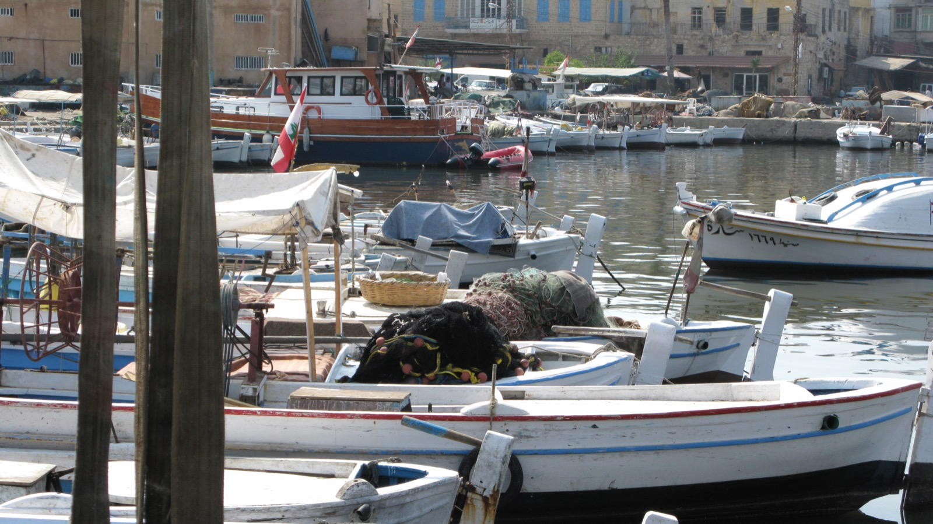
“A place for the spreading of nets”
THE PROPHECY (ESV)
TYRE TODAY
Ezekiel 26:4
“I will scrape her soil from her and make her a bare rock.”
Ezekiel 26:5
“She shall be in the midst of the sea a place for the spreading of nets, for I have spoken, declares the Lord GOD.”
Ezekiel 26:14
~700
fishermen work about 270 boats from Tyre’s ancient harbor today (AP, 2024)
“I will make you a bare rock. You shall be a place for the spreading of nets.”
Ezekiel 26:4–5, 14 (ESV); Associated Press, “Fishers at a Lebanese port hope ceasefire with Israel means normal life is returning” (Nov. 2024); World Bank, Cultural Heritage and Urban Development project, Tyre fishing harbor (2016). Photo: fishing nets on boats in Tyre harbor, Vyacheslav Argenberg (2008), Wikimedia Commons, CC BY 4.0
Notes:
Ezekiel 26:4 to 5 (ESV): 'They shall destroy the walls of Tyre and break down her towers, and I will scrape her soil from her and make her a bare rock. She shall be in the midst of the sea a place for the spreading of nets, for I have spoken, declares the Lord GOD. And she shall become plunder for the nations.' Ezekiel 26:14: 'I will make you a bare rock. You shall be a place for the spreading of nets. You shall never be rebuilt, for I am the LORD; I have spoken, declares the Lord GOD.' Photo: 'Harbor port, Tyre, Lebanon' by Vyacheslav Argenberg, taken 3 September 2008, Wikimedia Commons, licensed CC BY 4.0 (https://commons.wikimedia.org/wiki/File:Harbor_port,_Tyre,_Lebanon.jpg); it shows fishing nets piled on boats in the old harbor. Today: Tyre (Sour, Lebanon) is still a fishing town. In November 2024 the Associated Press reported about 700 fishermen working 270 boats from the ancient Phoenician port (most had been unable to sail during the Israel–Hezbollah fighting); a 2023 Reuters report put fishing employment in Tyre at about 2,000 people; a World Bank cultural heritage project (2016) describes the old harbor as still used by local fishermen. Alexander's causeway, built from the rubble of the mainland city in 332 BC, silted up over the centuries so that Tyre is now a peninsula. For Q&A: verse 14 also says 'You shall never be rebuilt', and a modern city of Tyre exists. The usual reply is that the ancient island city-state never recovered its former power; the old mainland city's rubble lies under the sea, and much of the ancient site is ruins or bare rock, with the modern town built on the silted-up peninsula. Present this carefully rather than claiming the area is uninhabited.

Slide 25
Prophecy fulfilled: the fall of Nineveh
THE PROPHECY: NAHUM, c. 663–612 BC
THE FULFILLMENT, 612 BC
Nahum 1:8
Babylonians and Medes besieged Nineveh for three months.
“With an overwhelming flood he will make a complete end of the adversaries.”
Nahum 2:6
“They carried off the vast booty of the city and the temple and turned the city into a ruin heap.”
“The river gates are opened; the palace melts away.”
Nahum 2:9
“Plunder the silver, plunder the gold! There is no end of the treasure.”
Babylonian Chronicle (BM 21901), British Museum
Excavators found burned palaces and the bodies of defenders at the city gates. Nineveh was never rebuilt.
Nahum 3:13, 15
“Fire has devoured your bars … There will the fire devour you.”
Dating: Nahum describes the fall of Thebes (663 BC) as past (3:8–10) and the fall of Nineveh as still to come.
Nahum 1:8; 2:6, 9; 3:8–15 (ESV); Fall of Nineveh Chronicle, BM 21901, trans. A. K. Grayson, Assyrian and Babylonian Chronicles (1975), no. 3
Notes:
Nahum prophesied the destruction of Nineveh, capital of the Assyrian empire. Dating: Nahum 3:8 to 10 refers to the fall of Thebes (No-Amon) to Assyria in 663 BC as already past, and Nineveh's fall (612 BC) as still to come, so the book was written between those dates. Key verses (ESV): 1:8, 'with an overwhelming flood he will make a complete end of the adversaries'; 2:6, 'The river gates are opened; the palace melts away'; 2:9, 'Plunder the silver, plunder the gold! There is no end of the treasure'; 3:13, 'fire has devoured your bars'; 3:15, 'There will the fire devour you.' Fulfillment: the Babylonian 'Fall of Nineveh Chronicle' (British Museum, BM 21901), year 14 of Nabopolassar (612 BC), records that the king of Akkad and Cyaxares the Mede besieged Nineveh for three months, from Simanu to Abu; the Assyrian king Sin-shar-ishkun died; 'They carried off the vast booty of the city and the temple and turned the city into a ruin heap' (trans. A. K. Grayson, Assyrian and Babylonian Chronicles, 1975, chronicle 3; livius.org). Excavations at Nineveh (e.g., David Stronach's work at the Halzi Gate, 1989 to 90) found evidence of fire and the bodies of defenders at the gates. Nineveh was never rebuilt as a capital; by the 2nd century AD Lucian could write that it had perished without a trace (Charon 23). Caution: the 'flood' detail is debated. A later tradition (Diodorus Siculus 2.26 to 27, from Ctesias) says a river flood broke the walls; the Babylonian Chronicle does not mention it, and some scholars read Nahum's flood as a figure for an overwhelming army. Present it as consistent with, not proven by, the record.

Slide 26
Isaiah 53: written before Jesus
Isaiah 53 (ESV) | Fulfilled in Jesus
“He was despised and rejected by men” (53:3) | Rejected, then given the most shameful death: Cicero said the very name of the cross should be far from Romans’ “thoughts, eyes, ears”
“He was pierced for our transgressions” (53:5) | Nailed to a cross; his side pierced (John 19:34; 20:25)
Together, 53:3 and 53:5 describe crucifixion, yet Isaiah wrote c. 700 BC, about two centuries before its first recorded use (Persia, 519 BC)
“Like a lamb that is led to the slaughter … he opened not his mouth” (53:7) | Silent before Pilate (Mark 15:5; Acts 8:32–35)
“They made his grave with the wicked and with a rich man in his death” (53:9) | Crucified between criminals, buried in a rich man’s tomb (Matt 27:38, 57–60)
“Numbered with the transgressors” (53:12) | Jesus applies this verse to himself (Luke 22:37)
THE GREAT ISAIAH SCROLL
c. 125 BC
Found at Qumran in 1947
All 66 chapters of Isaiah, including chapter 53
Copied over a century before Jesus was born
Isaiah wrote c. 700 BC, centuries before crucifixion came into use
This copy existed generations before Jesus, so these words cannot be later Christian additions.
Isaiah 53:3–12 (ESV); Great Isaiah Scroll (1QIsa-a), Israel Museum, Shrine of the Book; radiocarbon 356–103 BC, handwriting c. 150–100 BC
Notes:
The Great Isaiah Scroll (1QIsa-a) was found in Qumran Cave 1 in 1947 and is kept in the Shrine of the Book at the Israel Museum, Jerusalem. It contains the whole book of Isaiah, all 66 chapters in 54 columns, including chapter 53. It is usually dated to about 125 BC: radiocarbon tests give ranges between about 356 and 103 BC, and the style of handwriting points to about 150 to 100 BC. Either way, it was copied more than a century before Jesus was born, so the 'suffering servant' passage cannot have been written or edited by Christians after the fact. Prophecy and fulfillment (ESV): 53:3, despised and rejected (John 1:11; Mark 15:13 to 14); 53:5, pierced for our transgressions (John 19:34; 20:25); 53:7, like a lamb led to the slaughter, silent (Mark 14:61; 15:5); in Acts 8:32 to 35 Philip explains this very passage as being about Jesus; 53:9, his grave with the wicked and with a rich man in his death (crucified between two criminals, Matt 27:38; buried by the rich Joseph of Arimathea, Matt 27:57 to 60); 53:12, numbered with the transgressors, which Jesus quotes of himself in Luke 22:37. For Q&A: many Jewish interpreters read the servant of Isaiah 52:13 to 53:12 as the nation of Israel; Christians since the New Testament have read it as the Messiah. The manuscript point stands either way: the text was fixed long before Jesus. Cicero on the cross: in his speech For Rabirius (Pro Rabirio Perduellionis Reo 16, 63 BC) Cicero says, 'the executioner, the veiling of the head, and the very name of the cross (nomen ipsum crucis) should be far removed not only from the bodies of Roman citizens but even from their thoughts, eyes and ears.' (C. D. Yonge's translation renders crux as 'gibbet'.) It shows how shameful and horrifying crucifixion was, which fits 'despised and rejected' (53:3). Rows 1 and 2 together: a despised, public death by piercing is exactly what crucifixion was. Crucifixion timing: Encyclopaedia Britannica ('crucifixion', capital punishment) says crucifixion was used 'particularly among the Persians, Seleucids, Carthaginians, and Romans from about the 6th century BCE,' and gives its earliest dated example: 'In 519 BCE Darius I, king of Persia, crucified 3,000 political opponents in Babylon.' The slide says 'first recorded use', not 'invented', because earlier unrecorded use cannot be ruled out. Further detail: Isaiah ministered c. 740 to 680 BC. The first clear reports of crucifixion come from Persia about two centuries later: Herodotus (Histories 3.159) says Darius I 'impaled' or 'crucified' about 3,000 Babylonians, c. 520 BC (the Greek verb can mean either). Rome adopted crucifixion from Carthage, and it was a standard Roman punishment from about the 200s BC. In Isaiah's own day the Assyrians impaled captives on stakes, as shown on the Lachish reliefs from Sennacherib's palace (British Museum, c. 701 BC), and Jewish law hung a body on a tree only after death (Deut 21:22 to 23). Caution: Isaiah 53 says 'pierced' (Hebrew mecholal, 'pierced through' or 'wounded'), not 'crucified', so the claim is that it fits crucifixion, not that it names it. Many critical scholars date chapters 40 to 66 to about 540 BC; that is still before the first clear Persian crucifixions and centuries before Rome used it.

Slide 27
Doubted, then dug up
People and places once known almost only from the Bible, later confirmed by archaeology
The Hittite empire
Genesis 23; 2 Kings 7:6
Sargon II
Isaiah 20:1
Doubted: Not their existence but their power. F. W. Newman: “No Hittite kings can have compared in power with the king of Judah.”
Doubted: Isaiah calls him “Sargon the king of Assyria,” but scholars debated until the 1860s whether he was a separate king or another name for a known one.
Found 1906: Hattusa, Turkey: an imperial archive, including a treaty with Pharaoh Ramesses II as an equal
Found 1843: Botta uncovers his palace at Khorsabad, Iraq, with inscriptions recording his capture of Ashdod (Isaiah 20:1)
Belshazzar
Daniel 5
The house of David
1 Samuel–1 Kings
Doubted: Whether he existed at all. No record outside Daniel named him; ancient historians said Nabonidus was the last king.
Doubted: Whether King David was real. Philip Davies (1992) argued Israel’s early history was largely a later literary creation.
Found 1854: A cylinder from Ur names him Nabonidus’s eldest son; later texts show he ruled Babylon for his father
Found 1993: Tel Dan Stele (9th c. BC): an Aramean king boasts of defeating the king of the “House of David”
Doubts: Newman, History of the Hebrew Monarchy, in W. Wright, Empire of the Hittites (1884); Holloway in Mesopotamia and the Bible (2003), 70–71; Berossus in Josephus, Against Apion 1.20; P. R. Davies, In Search of ‘Ancient Israel’ (1992)
Notes:
Sources for the doubts. (1) Hittites: the doubt was not that the Hittites existed (Genesis names them as a people in Canaan) but that they were ever a great power. 2 Kings 7:6 says the Syrian army fled because it thought Israel had hired 'the kings of the Hittites and the kings of Egypt'. Francis W. Newman, A History of the Hebrew Monarchy, said of this narrative that 'the unhistorical tone is too manifest to allow of our easy belief in it', and: 'No Hittite kings can have compared in power with the king of Judah, the real and near ally, who is not named at all'; quoted in William Wright, The Empire of the Hittites (1884) and A. H. Sayce, The Hittites: The Story of a Forgotten Empire (1888). Before the 20th century the Bible was the only source naming the Hittites. Hugo Winckler's excavations at Hattusa (Bogazkoy) from 1906 found a royal archive of about 10,000 tablets, including the Hittite copy of the peace treaty between Hattusili III and Ramesses II (c. 1259 BC; the Egyptian copy is at Karnak) and letters in which Hittite, Egyptian, Babylonian and Assyrian kings address one another as 'Great King' and 'brother'. The Hittites had ruled an empire across Anatolia and northern Syria and fought Egypt at Kadesh (1274 BC). Accuracy note: that empire collapsed around 1180 BC; 2 Kings 7:6 (9th century BC) refers to 'the kings of the Hittites' in the plural, which fits the successor Neo-Hittite kingdoms of northern Syria (such as Carchemish) that Assyrian records of Shalmaneser III list as significant states. The 1906 finds overturned the view that the Hittites were ever insignificant. (2) Sargon II: Isaiah 20:1 (ESV) names him explicitly: 'In the year that the commander in chief, who was sent by Sargon the king of Assyria, came to Ashdod and fought against it and captured it'. It is his only mention in the Bible. The doubt was not that the name was unknown but whether Sargon was a separate king or another name for a known Assyrian king such as Shalmaneser or Sennacherib; he was barely mentioned in later ancient literature, and Assyriologists did not fully accept him as a distinct king until the 1860s (Steven W. Holloway, 'The Quest for Sargon, Pul and Tiglath-Pileser in the Nineteenth Century', in Mark W. Chavalas and K. Lawson Younger, eds., Mesopotamia and the Bible, 2003, 70 to 71). Paul-Emile Botta excavated his palace at Khorsabad (Dur-Sharrukin) from 1843; its inscriptions name Sargon as king and record his campaign against Ashdod (c. 712 to 711 BC), the very event Isaiah 20:1 dates by. (3) Belshazzar: the doubt was whether he existed at all, and whether Daniel was right to call him king. Before 1854 he was known only from Daniel 5 (and Baruch 1:11, which depends on it); the ancient historians Berossus (quoted in Josephus, Against Apion 1.20) and Herodotus named Nabonidus as Babylon's last king, which critics used against Daniel. In 1854 J. G. Taylor found foundation cylinders of Nabonidus at Ur (British Museum) praying for 'Belshazzar, my eldest son'. Later texts show Belshazzar ruled in Babylon as regent; see Alan R. Millard, 'Daniel and Belshazzar in History', Biblical Archaeology Review 11.3 (1985), 72 to 78. Daniel 5:29, where Belshazzar offers only the third place in the kingdom, fits that co-regency. (4) David: the doubt was whether King David was a real person and the founder of Judah's royal line. Philip R. Davies, In Search of 'Ancient Israel' (Sheffield: JSOT Press, 1992), argued that most of Israel's pre-exilic history in the Bible was a literary creation of the Persian period. The Tel Dan Stele (Avraham Biran and Joseph Naveh, Israel Exploration Journal, 1993) then gave the first reference to the 'House of David' outside the Bible: an Aramean king, probably Hazael of Damascus, boasts of killing the king of Israel and the king of the House of David, about 150 years after David's time. This shows Judah's kings were known by David's name as the dynasty's founder; it does not by itself confirm the details of David's reign. Davies disputed the reading ('House of David Built on Sand', BAR 20.4, 1994), but it is generally accepted (David Noel Freedman and Jeffrey Geoghegan, 'House of David Is There', BAR 21.2, 1995). Caution: these finds confirm the people and places, not every detail of the biblical accounts.

Slide 28
The Exodus: doubted, but the setting fits
THE DOUBT
EVIDENCE THAT FITS THE STORY
Israel Finkelstein & Neil Asher Silberman, The Bible Unearthed (2001):
the Exodus saga is “neither historical truth nor literary fiction.”
Ze’ev Herzog, Tel Aviv University (Haaretz, 1999):
the Israelites did not live in Egypt or make an exodus.
Their reason: no trace of a mass migration or 40 years in Sinai.
Avaris tomb: a high Semitic official buried in Egypt’s Delta, c. 1800–1700 BC; some argue it was Joseph
Brooklyn Papyrus (c. 1750 BC): Semitic servants in Egypt, one named Shiphrah (Exodus 1:15)
Beni Hasan painting (c. 1890 BC): Semitic travelers from Canaan shown arriving in Egypt
Pi-Ramesses: the store city “Raamses” of Exodus 1:11, next to Avaris
Egyptian names: Moses, Phinehas and Hophni are Egyptian, not Hebrew, names
Merneptah Stele (c. 1208 BC): “Israel” already a people in Canaan
“Asiatic” or “Semitic”: people from Canaan and Syria, not specifically Jews. Israel’s ancestors were among them, but no find names an Israelite.
This evidence supports the historicity of the Exodus, though it does not completely prove it.
Finkelstein & Silberman (2001); Herzog, “Deconstructing the Walls of Jericho,” Haaretz, 29 Oct. 1999; Papyrus Brooklyn 35.1446; J. K. Hoffmeier, Israel in Egypt (1997); Merneptah Stele, Egyptian Museum, Cairo
Notes:
The doubt. Israel Finkelstein and Neil Asher Silberman, The Bible Unearthed (Free Press, 2001), argue there was no single exodus as described, citing the absence of archaeological evidence for a mass migration from Egypt or a 40-year stay in Sinai; their conclusion: 'The saga of Israel's Exodus from Egypt is neither historical truth nor literary fiction. It is a powerful expression of memory and hope born in a world in the midst of change.' Ze'ev Herzog of Tel Aviv University, 'Deconstructing the Walls of Jericho', Haaretz Magazine, 29 October 1999 (republished in Prometheus 4, 2001), summarized the archaeological consensus as he saw it: the Israelites did not sojourn in Egypt or make an exodus, and did not conquer the land. Their main reasons: no Egyptian record of the event, no campsite remains in Sinai, and the very large numbers in the text (600,000 men, Exodus 12:37). Evidence that fits: (1) Avaris (Tell el-Dab'a): a large Semitic population from about 1830 BC; Manfred Bietak's excavations (1986 to 88) found a tomb with a smashed statue of a high-ranking Asiatic official, c. 1800 to 1700 BC; David Rohl and the film Patterns of Evidence identify him as Joseph, but no inscription names him and most Egyptologists reject Rohl's chronology, so present it as a Semitic official, possibly Joseph, not proven. Avoid calling him 'Jewish': we can identify him only as Asiatic or Semitic. 'Asiatics' is the Egyptologists' term (Egyptian 'Aamu') for people from Western Asia, mainly Semitic-speaking peoples of Canaan and Syria; the Hebrews would have been one such group, but 'Jews' (from Judah) is a much later term, and no Egyptian find of this period identifies anyone as an Israelite. (2) Papyrus Brooklyn 35.1446 (Brooklyn Museum, c. 1809 to 1743 BC) lists 95 household servants, many with Semitic names; the Brooklyn Museum states that scholars assume one entry is a hieroglyphic rendering of the Hebrew name Shiphrah, the name of a midwife in Exodus 1:15; it shows Semites as servants in Egypt, not that they were Israelites. (3) The tomb of Khnumhotep II at Beni Hasan (c. 1890 BC) shows a group of Asiatics (Aamu) arriving in Egypt. (4) Exodus 1:11 names the store city Raamses; Ramesses II's capital Pi-Ramesses (Qantir) lay beside Avaris. (5) Moses, Phinehas and Hophni are Egyptian names (James K. Hoffmeier, Israel in Egypt, Oxford University Press, 1997; Ancient Israel in Sinai, 2005). (6) The Merneptah Stele (c. 1208 BC, Egyptian Museum, Cairo) mentions 'Israel' as a people in Canaan, the earliest reference to Israel outside the Bible. Caution: scholars who accept an exodus disagree about its date (about 1446 BC or about 1260 BC), which changes which evidence lines up.

Slide 29

Three ways to approach the text
1
Textual Skepticism
2
Textual Absolutism
3
Textual Confidence
The road between the two ditches
Notes:
Two ditches on either side of the road: skepticism and absolutism. The aim is the road in the middle, textual confidence.

Slide 30
Textual skepticism: four claims
The Bible was made in AD 325 by Constantine and the Council of Nicaea
1
The church left out other gospels
2
We can’t know what the Gospels originally said
3
The Gospels are myths written long after the events
4
Notes:
A roadmap for the rest of the talk. 1. AD 325: the Nicaea and canon slides show the council dealt with Arius and Easter, and that the books were recognised by apostolic origin, widespread use and orthodoxy long before. 2. Left-out gospels: by AD 180 the church recognised only four Gospels; the others are second century or later. 3. The text: the Dead Sea Scrolls, the manuscript counts, the comparison with classical works, and the variant statistics (less than 1% meaningful and viable). 4. Myth: the New Testament was written about AD 50 to 100; the earliest manuscripts carry the authors' names; Tacitus, the Pilate coins and stone, and historians on the empty tomb corroborate the accounts.

Slide 31
What Nicaea was really about
Constantine called the council in AD 325 to settle a dispute over who Jesus is.
1
Arius and the divinity of Christ
WHAT IT DID NOT DO
Arius taught the Son was created. The council affirmed He is fully God in the Nicene Creed.
Decide the canon
The date of Easter
The churches recognised the books gradually:
2
c. 180
Irenaeus: four Gospels only
Set one common date for the whole church to celebrate it.
late 100s
Muratorian list: most of the NT
3
20 canons on church order
367
Athanasius: first list of our exact 27
Rules for bishops and clergy, and for restoring Christians who had lapsed.
393–397
Hippo and Carthage affirm the list
“The Council of Nicaea had nothing to do with the Canon.” Bill Mounce, Why I Trust My Bible
Notes:
The Council of Nicaea (AD 325) was called by Constantine to resolve the Arian controversy: Arius, a priest of Alexandria, taught that the Son was a created being who had a beginning. The council rejected this and produced the Nicene Creed, confessing the Son to be of the same substance (homoousios) as the Father. It also settled a common date for Easter and issued 20 canons on church discipline (ordination of bishops, conduct of clergy, readmission of the lapsed, the Melitian schism). None of its surviving documents, and none of the eyewitness accounts (Eusebius, Athanasius), mention which books belong in the Bible. The canon was recognised gradually: Irenaeus around 180 accepts only four Gospels; the Muratorian fragment (usually dated late 2nd century) lists most of the New Testament; Athanasius's Festal Letter 39 in AD 367 is the first list matching our 27 books exactly; the regional councils of Hippo (393) and Carthage (397) affirmed that list. The quote on the slide is from Bill Mounce's 'Why I Trust My Bible' course lecture on canonicity (BiblicalTraining.org), where he says Nicaea was about Arianism and the divinity of Christ, not the canon.

Slide 32



Truth: recognised, not invented
Every book was weighed by three tests. Later gospels, like Thomas and Peter, failed them:
1. Apostolic authority
2. Widespread use
3. Orthodoxy
Written by an apostle or a close associate of one
Read and used widely across the early church
Agrees with the rest of the books
“The canon is a list of authoritative books more than it is an authoritative list of books.”
Bruce M. Metzger, interviewed in Lee Strobel, The Case for Christ (Zondervan, 1998), ch. 3
Three tests: Metzger’s criteria (1987), as summarized in H.J. de Jonge, “The New Testament Canon” (Leiden University, 2001), p. 16.
Notes:
The quote on the slide is from Lee Strobel's interview with Bruce Metzger in The Case for Christ (Grand Rapids: Zondervan, 1998), chapter 3, 'The Documentary Evidence'. Metzger continues: these documents did not derive their authority from being selected; each one was authoritative before anyone gathered them together. Earlier slide quote, from his scholarly book: 'The Church did not create the canon, but came to recognize' it (Bruce M. Metzger, The Canon of the New Testament: Its Origin, Development, and Significance, Oxford: Clarendon Press, 1987, pp. 286 to 87). In that closing chapter (pp. 286–87) Metzger argues that no individual, synod or council created the canon; the books it excluded effectively excluded themselves. The Church came to recognize, accept, affirm and confirm writings whose authority was already self-evident and had imposed itself on the churches. He calls the result a case of 'the survival of the fittest'. Metzger names three criteria the early church used: (1) orthodoxy, agreement with the rule of faith handed down from the apostles; (2) apostolicity, written by an apostle or a close associate of one; (3) consensus among the churches, widespread and continuous acceptance across the church as a whole. These match the three tests on this slide. New Testament scholar H.J. de Jonge (Leiden University) summarizes the scholarship this way: Harry Gamble (1985) lists four criteria (apostolicity, catholicity, orthodoxy, traditional usage); Metzger (1987) names three, folding catholicity and traditional usage into 'consensus among the churches'; Karl-Heinz Ohlig found early Christian writers using as many as eleven ('The New Testament Canon', 2001, p. 16; hdl.handle.net/1887/2851). On p. 282 Metzger frames the key question as whether the canon is a collection of authoritative books or an authoritative collection of books; his answer, in his conclusion, is the former: the books were authoritative first, and the church recognised them. They also match the ones New Testament scholar Bill Mounce lays out in his 'Why I Trust My Bible' course (BiblicalTraining.org, lesson on canonicity) and his book Why I Trust the Bible (Zondervan, 2021): apostolic authorship, harmony with the rest of Scripture, and continual use by the church as a whole. He notes that 21 of the 27 New Testament books were accepted because of their apostolic origin (book, p. 103), and that heresy can only be recognised if a standard of truth already exists (p. 120).

Slide 33
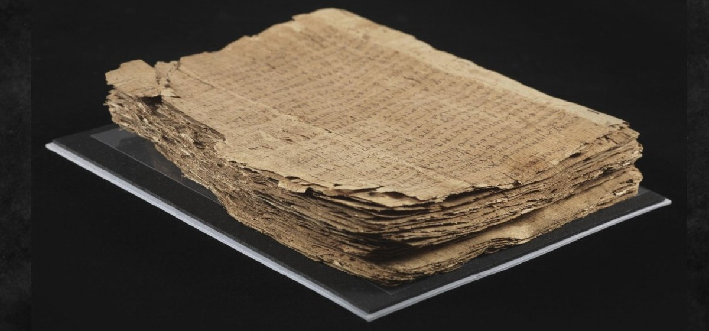
“We don’t know what the original manuscripts said.”
LIE
Bart Ehrman says there are “more variations among our manuscripts than there are words in the New Testament.”
Bart Ehrman, Misquoting Jesus (2005), p. 90
Let’s look at the evidence.
Notes:
Bart Ehrman, Misquoting Jesus (HarperSanFrancisco, 2005). On p. 90 he writes that there are more variations among our manuscripts than there are words in the New Testament; it is a favourite line of his in interviews too. On p. 10 he says we have neither the originals nor the first copies, only much later copies that differ in so many places that the differences cannot even be counted. Note: he says words, not verses (about 138,000 words in the Greek New Testament against roughly 400,000 variants). Daniel Wallace's review (JETS 49/2, 2006, pp. 327–49) documents these quotations and answers them: the high number reflects how many manuscripts we have, and most variants are spelling. Ehrman himself concedes in the paperback appendix that essential Christian beliefs are not affected by textual variants (see the Ehrman slide later).

Slide 34
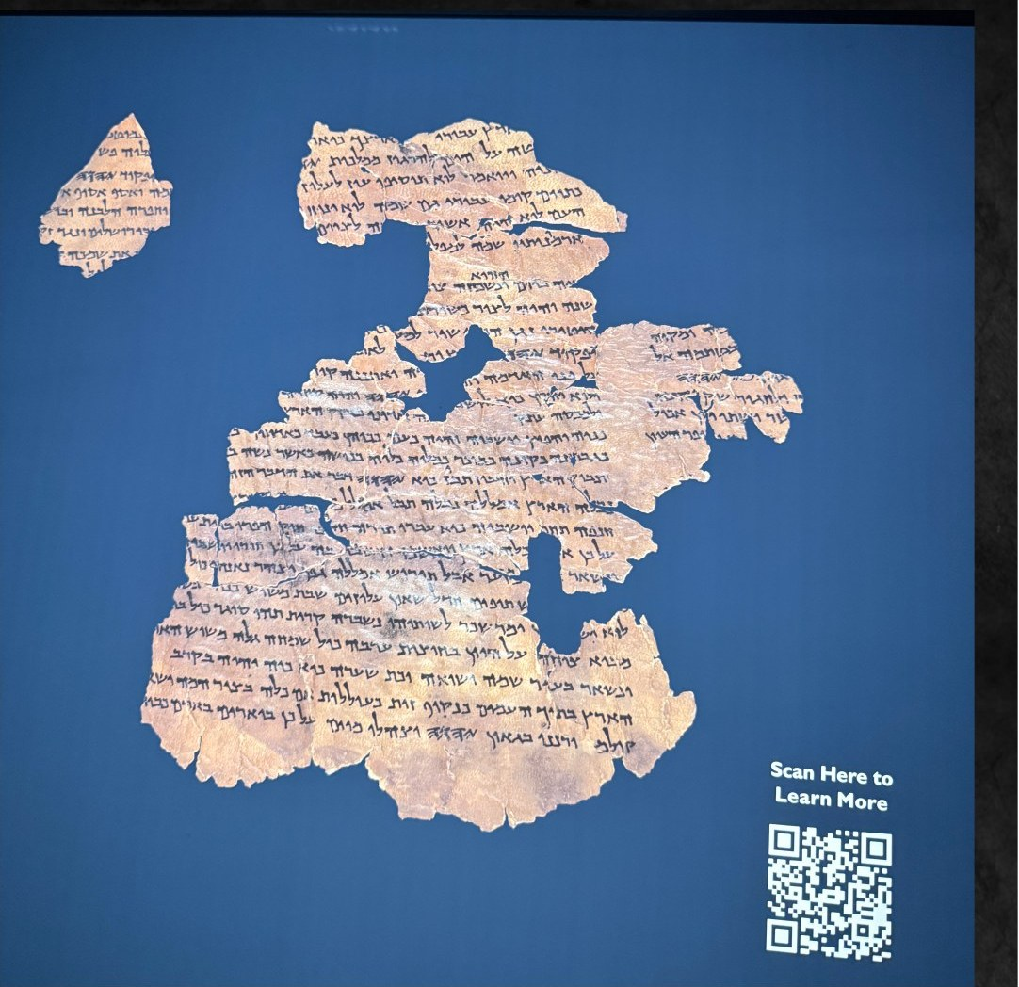
1,000 years apart, the same message
BEFORE 1947
Masoretic Text
Our oldest Hebrew copies: c. AD 900–1000. Trusted, but late.
going back about 1,000 years
FOUND 1947–1956
Dead Sea Scrolls
Copies from c. 250 BC – AD 68, found near Qumran.
The Isaiah scrolls from Cave 1 “proved to be word for word identical with our standard Hebrew Bible in more than 95 percent of the text.”
Gleason L. Archer, A Survey of Old Testament Introduction (Moody, 1964), p. 19
Notes:
Before 1947 the oldest Hebrew Old Testament manuscripts were Masoretic copies from about AD 900 to 1000: the Aleppo Codex (about AD 930) and the Leningrad Codex (AD 1008, the oldest complete Hebrew Bible). The Dead Sea Scrolls, found in eleven caves near Qumran between 1947 and 1956, date from about 250 BC to AD 68 (Israel Antiquities Authority, Leon Levy Dead Sea Scrolls Digital Library). The Great Isaiah Scroll (1QIsa-a, about 125 BC, Israel Museum, Shrine of the Book) is the only complete book among them. Gleason L. Archer, A Survey of Old Testament Introduction (Chicago: Moody, 1964), p. 19, checked in the Internet Archive scan: even though the two copies of Isaiah discovered in Qumran Cave 1 in 1947 were a thousand years earlier than the oldest dated manuscript previously known (AD 980), they proved to be word for word identical with our standard Hebrew Bible in more than 95 percent of the text; the 5 percent of variation consisted chiefly of obvious slips of the pen and variations in spelling. Later editions repeat this on a different page. The Septuagint, a Greek translation made before Christ, is a further witness.

Slide 35
New Testament manuscripts
138,000
400,000
70%
words in the Greek New Testament
textual variants among manuscripts
of variants are spelling differences
More variants exist because we have far more copies, not because the text is less certain.

Slide 36
Sorting the 400,000 variants
Meaningful, not viable
Meaningful and viable
Only variants that both change the meaning and could plausibly be original matter.
<1%
That is less than 1% of all variants.
Not meaningful, not viable
Viable, not meaningful
Daniel B. Wallace, JETS 49/2 (2006), p. 330; interview with Justin Taylor, The Gospel Coalition (2012)
Notes:
Daniel B. Wallace (Dallas Theological Seminary; founder of the Center for the Study of New Testament Manuscripts) sorts textual variants into four groups: (1) spelling and nonsense readings, at least 75% of all variants; (2) changes that cannot be translated, and synonyms; (3) meaningful variants that are not viable, i.e. they change the sense but have no real claim to be original (for example a reading in one late manuscript); (4) meaningful and viable variants, less than 1% of all variants. Sources: interview with Justin Taylor, The Gospel Coalition blog, 22 March 2012; and Wallace, 'The Gospel According to Bart: A Review Article of Misquoting Jesus by Bart Ehrman', Journal of the Evangelical Theological Society 49/2 (2006), p. 330: 'only about 1% of the textual variants are both meaningful and viable.' Fuller treatment: Komoszewski, Sawyer and Wallace, Reinventing Jesus (Kregel, 2006), section 'Politically Corrupt?'.

Slide 37
1,408 meaningful and viable variants
How confident was the UBS text committee about each one?
373
places with significant doubt (C + D)
0.09%
of the 400,000 variants: less than a tenth of one percent
Source: William D. Mounce, Why I Trust the Bible (Zondervan, 2021), from the UBS Greek New Testament’s ratings
Notes:
Source: William D. Mounce, Why I Trust the Bible (Grand Rapids: Zondervan, 2021), chapter on textual criticism. Mounce tabulates the United Bible Societies' Greek New Testament, whose apparatus lists 1,408 variants with the committee's confidence rating for each: A, text is certain (502); B, almost certain (533); C, the committee had difficulty deciding (366); D, great difficulty deciding (7). He concludes that the UBS text identifies 373 places out of 1,408 where there was significant doubt about a meaningful variant, which is 0.09 percent of the roughly 400,000 variants. Note: the UBS apparatus lists only variants significant for translators, so all 1,408 are meaningful; the counts differ slightly between UBS editions.

Slide 38
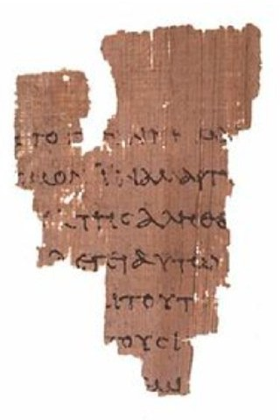
Witnesses to the text
25,000+
manuscript copies, and more being found
5,800+
in the original Greek
1 Million+
New Testament quotations by early church fathers
Counts: Daniel B. Wallace, interview with Justin Taylor, The Gospel Coalition (2012)
“If you did not have any of these other witnesses, we could reconstruct virtually the entire New Testament many, many times over on the basis of these quotations by the Church fathers alone.”
Daniel B. Wallace, lecture at SymposiaChristi, Purdue University (2016)
Notes:
Sources. Greek manuscripts and patristic quotations: Daniel B. Wallace (Dallas Theological Seminary; Center for the Study of New Testament Manuscripts), interview with Justin Taylor, The Gospel Coalition, 22 March 2012: over 5,800 Greek manuscripts have been catalogued; the early versions (Latin, Coptic, Syriac, Armenian, Georgian, Gothic and others) number in the tens of thousands, though they have not all been counted; and more than one million New Testament quotations by the church fathers have been tabulated. Latin alone has more than 10,000 manuscripts, so 25,000+ in all is a common estimate. Reconstructing the New Testament from the fathers: Bruce Metzger and Bart Ehrman, The Text of the New Testament, 4th ed. (Oxford University Press, 2005), p. 126, say the patristic citations are so extensive that, if all other sources were destroyed, they would be sufficient alone for the reconstruction of practically the entire New Testament (cited with that page in Bock and Wallace, Dethroning Jesus, 2007). The quote on the slide is Wallace's own words in his lecture at SymposiaChristi 2016, Purdue University (YouTube: https://youtu.be/ECdq5yv7HOc?t=1956, about 32:36), as quoted by Mel Wild, 'Why We Can Trust the New Testament' (2017). He says the same in his BiblicalTraining.org course (Introduction to Textual Criticism, lesson 6, 'Why Do We Have So Many Variants?'), and in his 2012 debate with Ehrman at UNC Chapel Hill he attributed the claim to Metzger and Ehrman. That is the sense in which 'even Ehrman' has said it. Caution: Ehrman has since argued on his blog that this claim is naive in practice, because a father's quotation does not always show the exact wording he read.

Slide 39
Bible reliability compared
Work | Written | Earliest copy | Time span (yrs) | Copies
Homer, Iliad | 900 BC | 400 BC | 500 | ~1,800
Plato | 427–347 BC | AD 900 | 1,300 | 210
Aristotle | 384–322 BC | AD 1100 | 1,400 | 40
Caesar, Gallic Wars | 100–44 BC | AD 900 | 1,000 | 251
Tacitus, Annals | AD 56–120 | AD 1000 | 900 | 31
Herodotus, History | 484–425 BC | AD 100 | 600 | 109
Livy, History of Rome | 59 BC–AD 17 | AD 300 | 400 | 90
New Testament | AD ~50–100 | Portions AD 100–150; entire NT c. AD 300 | 29–100 | 5,838 Greek MSS
Source: EvangelicalBible.com. NT also: 18,524 early translations; ~42,000 OT scrolls and codices.

Slide 40
If we stacked the manuscripts…
AVERAGE CLASSICAL WORK
NEW TESTAMENT: GREEK ONLY
NEW TESTAMENT: ALL LANGUAGES
~15 copies
5,800 manuscripts
~25,800 manuscripts
STACKED
STACKED
STACKED
~4 ft
~1,400 ft
6,235 ft
about the height of a pulpit
almost the Empire State Building (1,454 ft)
over a mile: more than 4 Empire State Buildings
Method: Wallace measured 20 Greek manuscripts in the National Library of Greece: on average 239 leaves and 2.9 inches thick.
Daniel B. Wallace, “How Tall Would a Stack of New Testament Manuscripts Be?” (2023); lecture “Is What We Have Now What They Wrote Then?”
Notes:
Daniel B. Wallace, 'How Tall Would a Stack of New Testament Manuscripts Be?', danielbwallace.com, 1 January 2023, and his lecture 'Is What We Have Now What They Wrote Then?' (YouTube: https://www.youtube.com/watch?v=n5AKPiBZcis). Wallace measured twenty Greek New Testament manuscripts at the National Library of Greece: they averaged 239 leaves and 2.9 inches thick, including covers. Times about 5,800 Greek manuscripts, that is about 1,402 feet, almost the Empire State Building (1,454 feet with antenna). Adding an estimated 15,000 to 20,000 manuscripts in early translations (mostly Latin) gives 5,027 to 6,235 feet; four Empire State Buildings stacked are 5,816 feet. For the average classical author he estimates about 15 manuscripts per work, a stack of about 3.6 feet, rounded to 4 feet; he calls this a broad estimate, not a scientific count.

Slide 41
Now to scale
6,235 ft
1 mile (5,280 ft)
~1,400 ft
Empire State (1,454 ft)
4 ft
Average classical work
NT: Greek manuscripts
NT: all manuscripts
Notes:
Drawn to scale from Wallace's figures. At this scale the average classical work's 4-foot stack is a sliver too thin to see; the full New Testament stack is over a mile tall. Source as on the previous slide.

Slide 42
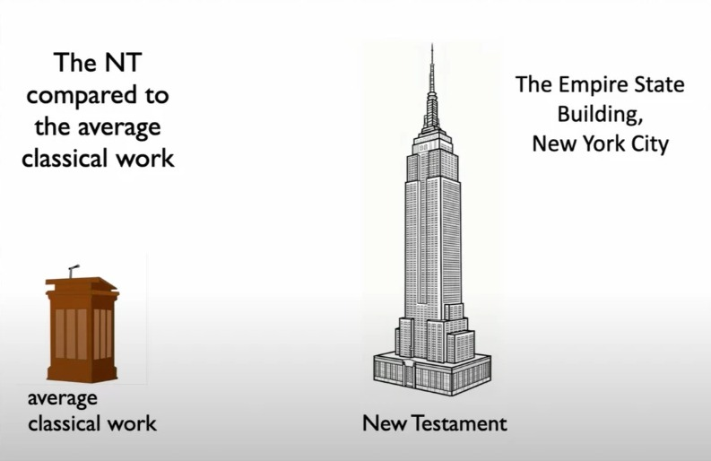
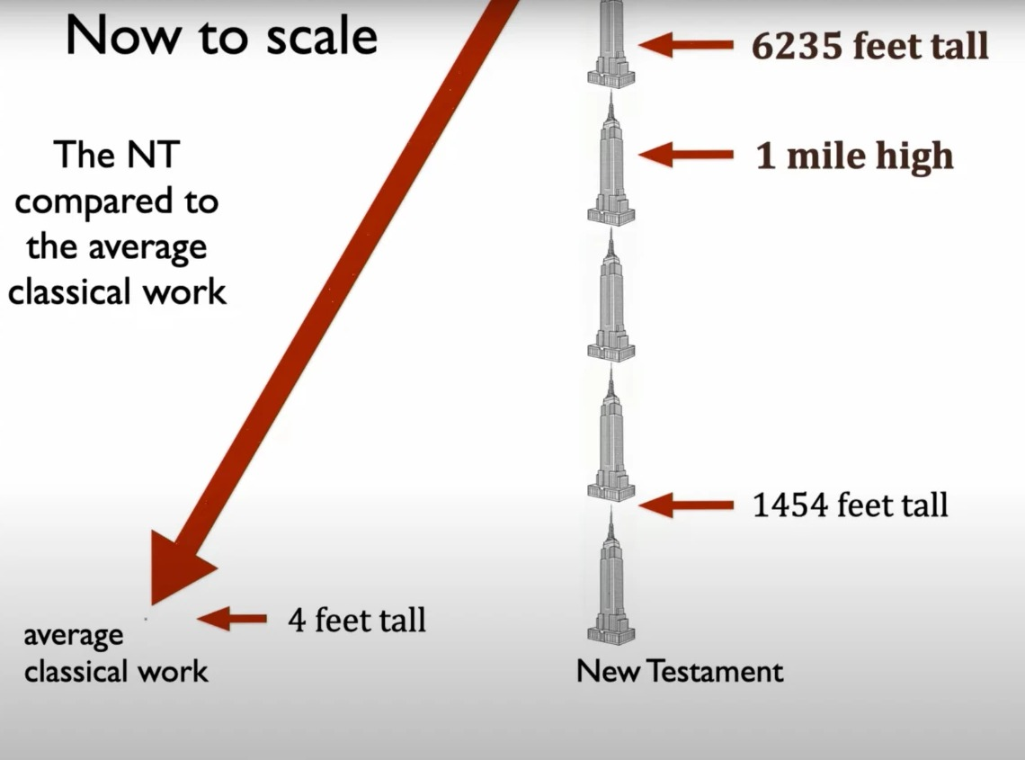
A pulpit next to the New Testament stack
Classical work: about 4 ft of manuscripts. New Testament: about 6,235 ft, over a mile high.
Images: Daniel B. Wallace, “Is What We Have Now What They Wrote Then?”, lecture, Dallas Theological Seminary (youtube.com/watch?v=n5AKPiBZcis)
Notes:
These two images are Daniel B. Wallace's own slides from his Dallas Theological Seminary lecture 'Is What We Have Now What They Wrote Then?' (YouTube, n5AKPiBZcis), shown with credit. Drawn to scale from Wallace's figures: the stack of all known New Testament manuscripts (about 25,800, Greek plus early translations) would be about 6,235 feet, a little more than four Empire State Buildings (1,454 feet each with antenna, 5,816 feet for four) and over a mile. The average classical work's stack of about 4 feet, roughly a pulpit, is the tiny mark on the ground line at this scale; the pulpit in the box is enlarged so it can be seen. Source: Daniel B. Wallace, 'How Tall Would a Stack of New Testament Manuscripts Be?' (2023), and his lecture 'Is What We Have Now What They Wrote Then?'.

Slide 43
New Testament vs. classical authors
1,000×
1,000×
1,000
more evidential
more material evidence
years earlier, as much as
“We have more than 1,000 times the manuscript data for the NT than we do for the average Greco-Roman author.”
Daniel B. Wallace, interview with Justin Taylor, The Gospel Coalition (2012); Wallace, “Textual Criticism,” BiblicalTraining.org, lesson 3
Notes:
Sources. Daniel B. Wallace, interview with Justin Taylor, The Gospel Coalition blog, 22 March 2012: the average classical author's literary remains number no more than twenty copies; we have more than 1,000 times the manuscript data for the NT than for the average Greco-Roman author; the extant manuscripts of the average classical author are no earlier than 500 years after he wrote, while for the NT we wait mere decades. In his BiblicalTraining.org course on New Testament textual criticism (lesson 3, 'The Number of Variants') Wallace says we have about a thousand times as much material as the average classical author, and manuscripts that come, on average, a thousand years earlier. The gap varies by author: about 500 years at minimum, often closer to 1,000.

Slide 44
When were the Gospels written?
Jesus born
Crucifixion and resurrection
c. 6–4 BC
AD 30 or 33
Creed, 1 Cor 15:3–7
c. AD 32–36
1 Corinthians
AD 53–55
Mark
AD 55–70
Matthew
AD 60–85
Luke
AD 60–85
John
AD 85–95
AD 1
10
20
30
40
50
60
70
80
90
100
“Christ died for our sins in accordance with the Scriptures, that he was buried, that he was raised on the third day in accordance with the Scriptures, and that he appeared to Cephas, then to the twelve.” 1 Corinthians 15:3–5 (ESV)
“He appeared to more than five hundred brothers at one time, most of whom are still alive.” 1 Corinthians 15:6 (ESV)
Notes:
Jesus' birth: before the death of Herod the Great in 4 BC (Matthew 2), so about 6 to 4 BC. Crucifixion: under Pontius Pilate, most often dated AD 30 or 33. Gospel dates are typical scholarly ranges: Mark about AD 55 to 70; Matthew and Luke about AD 60 to 85; John about AD 85 to 95. Many conservative scholars date Mark, Matthew and Luke before AD 70, partly because Acts (Luke's second volume) ends with Paul still alive in Rome around AD 62, and none of the Synoptics mentions the fall of Jerusalem in AD 70 as past. Even on later datings, all four were written within 60 years of Jesus' death, while eyewitnesses were still alive. Paul's letters are earlier still (about AD 48 to 64); 1 Corinthians (about AD 53 to 55) passes on a creed about the resurrection (15:3 to 7) that scholars date to within a few years of the crucifixion, and in 15:6 Paul says Jesus appeared to more than five hundred people at once, most of whom were still alive: an open invitation to check with living witnesses. The verse is quoted from the ESV; 1 Corinthians is a letter of Paul, not part of Acts. The creed: in 15:3 Paul says he 'delivered' what he had 'received', the technical language for passing on fixed tradition. Most scholars, including sceptics such as Gerd Lüdemann, date this creed to within a few years of the crucifixion; Paul probably received it in Jerusalem about AD 35 to 36, when he met Peter and James (Galatians 1:18 to 19). It is widely regarded as the earliest Christian creed we have. Ranges on the chart are typical scholarly dates; Paul and all four Gospels wrote while eyewitnesses were still alive.

Slide 45
Written vs. earliest surviving copy
WRITTEN
EARLIEST COPY (CSNTM DATE)
Matthew
P104
2nd century
Mark
P45
3rd century
Luke
P4, P75
3rd century
John
P52, P90
2nd century
AD 1
AD 50
AD 100
AD 150
AD 200
AD 250
AD 300
The gap ranges from decades to about two centuries. For the average classical author it is 500 to 1,000 years.
Manuscript dates: Center for the Study of New Testament Manuscripts (CSNTM), manuscripts.csntm.org
Notes:
Earliest surviving Greek manuscripts of each Gospel, with dates as catalogued by the Center for the Study of New Testament Manuscripts (manuscripts.csntm.org): Matthew, P104 (P. Oxy. 4404, Sackler Library, Oxford), 2nd century. Mark, P45 (Chester Beatty Library, Dublin), 3rd century; P45 also contains parts of all four Gospels and Acts. Luke, P4 (Bibliothèque nationale, Paris) and P75 (Vatican Library), both 3rd century; many scholars place P75 around AD 175 to 225. John, P52 (John Rylands Library, Manchester) and P90 (Oxford), both 2nd century; P66 (Bodmer) is 2nd to 3rd century. Note: P137, a fragment of Mark 1 published in 2018 and dated late 2nd to early 3rd century, is not yet in the CSNTM catalogue. Writing dates as on the previous slide. For comparison, Wallace notes that the earliest copies of the average classical author come at least 500 years after the original.

Slide 46
Earliest copies: Acts to Revelation
Book | Earliest manuscript | Approx. date
Acts | P45 (Chester Beatty I) | c. AD 200–250
Romans–Philemon (most of Paul) + Hebrews | P46 (Chester Beatty II) | c. AD 200
2 Thessalonians | P30 (P.Oxy. 1598) | 3rd century
1 Timothy | P133 (P.Oxy. 5259) | 3rd century
2 Timothy | Codex Sinaiticus | c. AD 330–360
Titus | P32 | c. AD 200
Philemon | P87 | c. AD 250
James | P23 (P.Oxy. 1229) | c. AD 200–250
1–2 Peter, Jude | P72 (Bodmer); P78 (Jude) | c. AD 250–300
1 John | P9 (P.Oxy. 402) | 3rd century
2–3 John | Codex Vaticanus | c. AD 325–350
Revelation | P98 (disputed); P115 | c. AD 150–275
P46
nine of Paul’s letters in one book, about 140 years after he wrote
Sinaiticus
earliest complete New Testament, c. AD 330–360
40–150 yrs
gap from writing to earliest copy for the New Testament; 700–1,400 years for Tacitus, Caesar and Plato
Dates per the Gregory-Aland registry (INTF, Münster); handwriting-based dates carry ±25–50 years. Habermas & Licona (2004), 33; Wallace, ed., Revisiting the Corruption of the New Testament (2011)
Notes:
Earliest surviving manuscript for each New Testament book after the Gospels (the Gospels are on the previous slide: Matthew P104, c. AD 150 to 200; Mark P137, c. AD 150 to 250, or P45 in the CSNTM catalogue; Luke P4 and P75, c. AD 175 to 225; John P52, c. AD 125 to 175). Designations and dates follow the standard Gregory-Aland registry kept by the Institute for New Testament Textual Research (INTF) in Münster; dates based on handwriting carry a margin of about 25 to 50 years. P46 contains nine Pauline letters plus Hebrews in a single codex, about 140 years after Paul wrote. The earliest complete New Testament is Codex Sinaiticus (c. AD 330 to 360). For comparison, most classical works have gaps of 700 to 1,400 years to their earliest copies; the New Testament gap is about 40 to 150 years, with about 5,800 Greek manuscripts. Avoid aggressive early datings seen online (P52 at AD 90, P64 at the AD 60s); these ranges are the defensible mainstream ones. Sources: Habermas and Licona, The Case for the Resurrection of Jesus (Kregel, 2004), 33; Daniel B. Wallace, ed., Revisiting the Corruption of the New Testament (Kregel, 2011).

Slide 47
Even the skeptic agrees
The question
Ehrman’s response
“Why do you believe these core tenets of Christian orthodoxy to be in jeopardy based on the scribal errors you discovered in the biblical manuscripts?”
“Essential Christian beliefs are not affected by textual variants in the manuscript tradition of the New Testament.”
Bart Ehrman, Misquoting Jesus (appendix to paperback edition, p. 252)

Slide 48
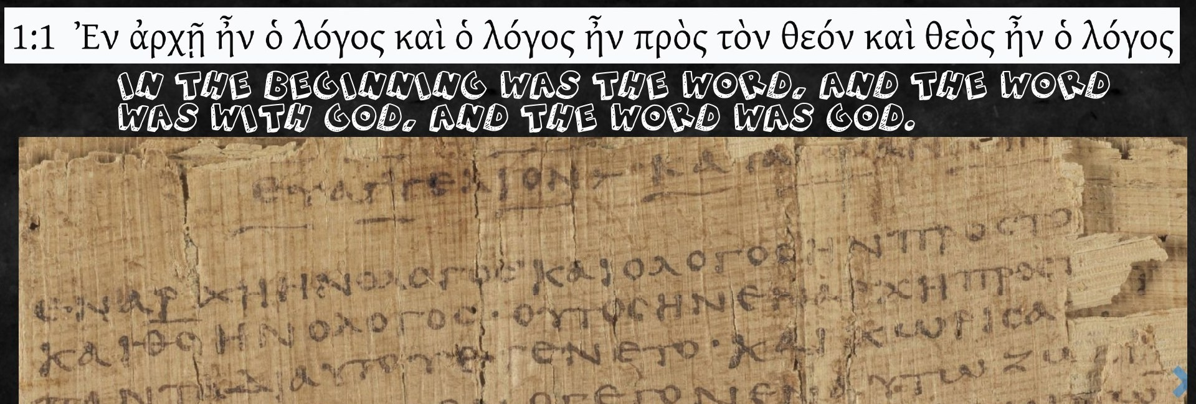
“In the beginning was the Word…”
Every manuscript of John 1:1 says the same thing: “the Word was God.”
Notes:
John 1:1: In the beginning was the Word, and the Word was with God, and the Word was God. The papyrus pictured is P66 (about AD 200), one of the earliest copies of John. The standard critical editions (Nestle-Aland 28, UBS5) record no variant that changes any clause of John 1:1, and the published lists of significant variants in John start at 1:4. Every surviving Greek manuscript reads 'and the Word was God' (theos en ho logos); the only differences anyone points to are trivial (for example, a later manuscript adding the article before 'God', which if anything makes the statement more emphatic). Early translations (Latin, Syriac, Coptic) agree.

Slide 49
“We don’t even know who wrote the Gospels. The names were added much later.”
LIE
TRUTH
Our earliest manuscripts have the names of the authors written on them.

Slide 50
The Gospels were always attributed
~180 AD
Matthew
Mark
Irenaeus (2nd century) attributes the Gospels to:
Luke
John
In the early church, the authorship of the four Gospels was never debated.

Slide 51
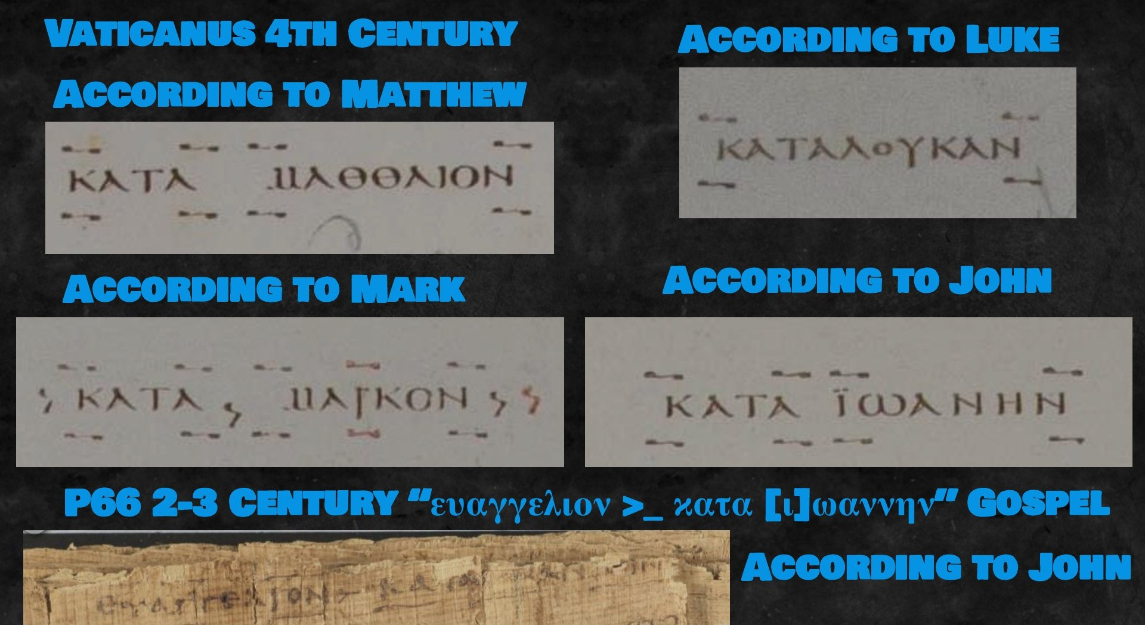
The names are on the manuscripts
“There are no anonymous copies of the Gospels, and there are no copies of the canonical Gospels under different names.”
Craig A. Evans, Jesus and the Manuscripts (2020), p. 53, quoted in Mounce, Why I Trust the Bible
“These titles were added sometime before the end of the first century.” William D. Mounce, Why I Trust the Bible (2021), citing Martin Hengel
Notes:
Codex Vaticanus (4th century) heads the Gospels 'According to Matthew', 'According to Mark', 'According to Luke', 'According to John'; Papyrus P66 (about AD 200) has 'Gospel according to John'. William D. Mounce, Why I Trust the Bible (Zondervan, 2021), section 'Titles': it has long been said that the Gospels are anonymous, and at one level that is true, because the authors' names are not embedded in the text itself. But every manuscript that preserves the beginning of a Gospel carries a title. Mounce quotes Craig A. Evans, Jesus and the Manuscripts (Hendrickson, 2020), p. 53: 'There are no anonymous copies of the Gospels, and there are no copies of the canonical Gospels under different names.' So there was never a rival tradition of who wrote them. Following Martin Hengel (Studies in the Gospel of Mark), Mounce says titles like 'According to Mark' were used much earlier than once suspected and were added sometime before the end of the first century, most likely once churches had more than one Gospel and needed to tell them apart. See also Simon Gathercole, 'The Alleged Anonymity of the Canonical Gospels', Journal of Theological Studies (2018).

Slide 52
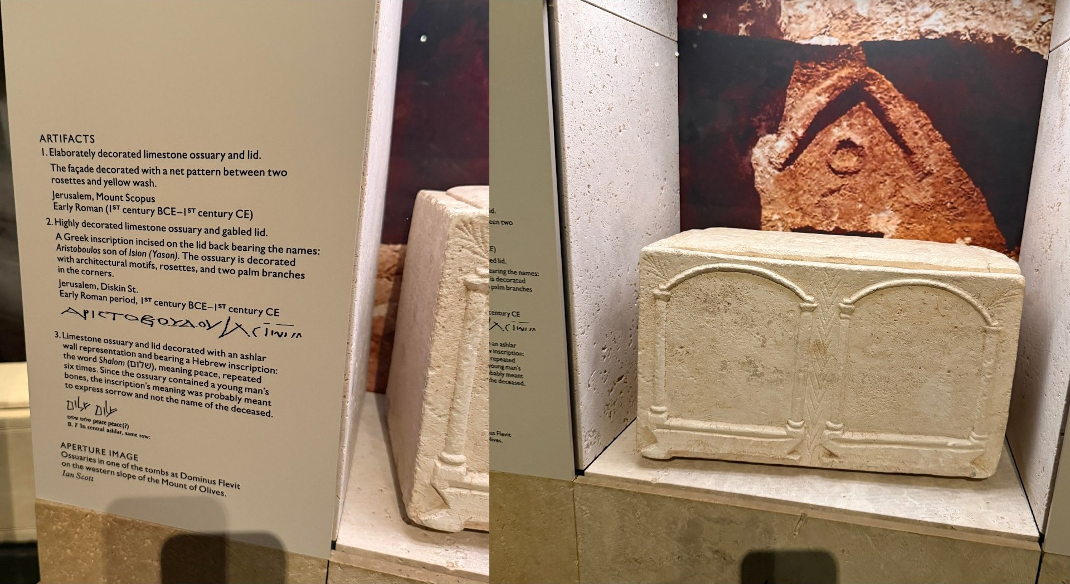
First-century names, set in stone
Limestone ossuaries from 1st-century Jerusalem carry the personal names common at the time.
One lid reads “Aristoboulos son of Ision (Yason)”.

Slide 53
The names fit the time and place
Men named… | Palestine (Ilan) | Gospels & Acts
Simon or Joseph | 16% | 18%
One of the 9 most common names | 41.5% | 40.3%
A name no one else had | 8% | 4%
THE DATA
Dr. Tal Ilan
Her Lexicon of Jewish Names in Late Antiquity (2002) catalogues Jews in Palestine, 330 BC to AD 200, from ossuaries, Josephus, the Dead Sea Scrolls and more: 2,953 name occurrences.
MOST COMMON MEN’S NAMES
Fiction gets this wrong. A 2024 statistical study found the Gospels’ names fit the real population as well as Josephus does, and better than ancient fictional texts or well-researched modern historical novels.
Simon, Joseph, Lazarus, Judas, John, Jesus
the same names that fill the Gospels
Sources: Richard Bauckham, Jesus and the Eyewitnesses, 2nd ed. (2017), pp. 71–72; Tal Ilan, Lexicon of Jewish Names in Late Antiquity, Part I (2002); van de Weghe & Wilson, “Why Name Popularity is a Good Test of Historicity” (2024)
Notes:
Tal Ilan, Lexicon of Jewish Names in Late Antiquity, Part I: Palestine 330 BCE to 200 CE (Tübingen: Mohr Siebeck, 2002), catalogues the names of Jews in Palestine from every available source: Josephus, the New Testament, the Judean desert and Masada documents, early rabbinic literature and Jerusalem ossuary inscriptions. Richard Bauckham used it in Jesus and the Eyewitnesses (Eerdmans, 2006; 2nd ed. 2017), chapter 4. He counts 2,953 occurrences of 521 names (2,625 male, 328 female) (p. 71). Simon and Joseph are the two most popular male names in each of the New Testament, Josephus, the ossuaries and the Judean desert texts (p. 71). Comparison (pp. 71 to 72): men named Simon or Joseph, about 16% in Palestine vs 18% in the Gospels and Acts; one of the nine most popular names, 41.5% vs 40.3%; a name attested only once, about 8% vs 4%. The six most popular male names were Simon, Joseph, Lazarus (Eleazar), Judas, John and Jesus (p. 85). The Gospels also use the distinguishing tags people needed when so many shared a name: Simon Peter, Simon the Zealot, Judas Iscariot, Mary Magdalene. The point: names in the Gospels match the real naming pattern of first-century Jewish Palestine, which differed from Jews elsewhere (e.g. Egypt), something a later writer outside Palestine would be very unlikely to reproduce. Luuk van de Weghe and Jason Wilson (Biola University), 'Why Name Popularity is a Good Test of Historicity', 2024 (arXiv 2403.14883), used chi-squared goodness-of-fit tests and found the Gospels-and-Acts names fit their historical context at least as well as Josephus, and better than ancient fictional sources and modern historical novels such as Ben-Hur.

Slide 54
Mark names his eyewitnesses
NAMES ONLY MARK GIVES
INCLUSIO
Peter first and last
Person | Mark | Matthew / Luke
Blind man at Jericho | “Bartimaeus, son of Timaeus” (10:46) | unnamed (Matt 20:30; Luke 18:35)
Man who carried the cross | Simon, “father of Alexander and Rufus” (15:21) | Simon only (Matt 27:32; Luke 23:26)
Mark 1:16 Simon is the first disciple named
Mark 16:7 “tell his disciples and Peter” is the last
Ancient writers bracketed a story with their main eyewitness. Mark marks Peter as his source, as early church tradition also says.
Why name them? They were known people, some still alive, whom Mark’s first readers could ask. Mark mentions Alexander and Rufus as if his readers already knew them.
Richard Bauckham, Jesus and the Eyewitnesses, 2nd ed. (Eerdmans, 2017), ch. 3 (names) and pp. 124–27 (Peter inclusio)
Notes:
Richard Bauckham, Jesus and the Eyewitnesses (Eerdmans, 2006; 2nd ed. 2017). Inclusio of eyewitness testimony (chapters 6 and 7; on Peter, 2nd ed. pp. 124 to 127): ancient biographies such as Lucian's Alexander and Porphyry's Life of Plotinus mark their main source by making that person the first and last individual named. In Mark, Simon is the first disciple named (1:16, mentioned twice in that verse) and Peter the last (16:7, 'go, tell his disciples and Peter'), bracketing the Gospel with Peter. This fits the early testimony of Papias (about AD 110, quoted by Eusebius, Church History 3.39.15) that Mark wrote down Peter's teaching. Named minor characters (chapter 3): Bauckham notes that Mark names some otherwise minor people (Bartimaeus, Jairus, Simon of Cyrene and his sons, the women at the tomb) and argues they were eyewitnesses known in the early church, who told their own stories; Matthew and Luke sometimes drop these names (Bartimaeus is unnamed in Matthew 20:30 and Luke 18:35; the sons of Simon of Cyrene appear only in Mark 15:21), which suggests the people were less well known to later readers, perhaps because they had died. Bauckham also observes (pp. 40 to 44) that Matthew and Luke drop names from Mark but do not invent names for people Mark leaves anonymous, the opposite of what later legend-making does. Summary of the inclusio: Köstenberger, Kellum and Quarles, The Cradle, the Cross, and the Crown (2009).

Slide 55
“Again these features of the New Testament data would be difficult to explain as the result of random invention of names within Palestinian Jewish Christianity and impossible to explain as the result of such invention outside Jewish Palestine. All the evidence indicates the general authenticity of the personal names in the Gospels.”
Richard Bauckham, Jesus and the Eyewitnesses (2nd ed.), p. 84

Slide 56
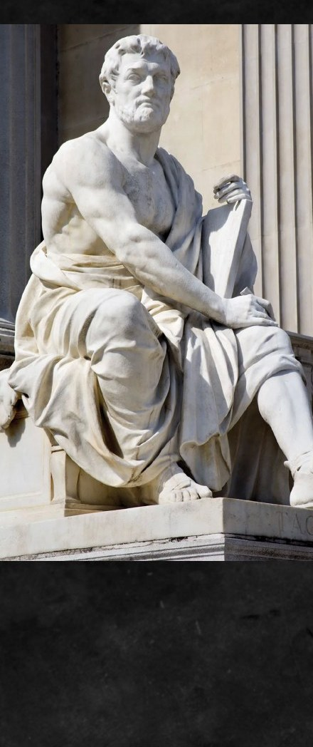
Tacitus: Rome’s great historian
Born AD 56, died c. 120
Roman senator, consul and governor of Asia
The Annals
History of the Roman Empire, AD 14 to 68
31 copies
Earliest is 900 years after he wrote, yet historians trust him
WHAT OTHERS SAY
“probably the greatest historian … who wrote in the Latin language”
Encyclopaedia Britannica, “Tacitus”
“the philosophic historian whose writings will instruct the last generations of mankind”
Edward Gibbon, Decline and Fall of the Roman Empire, ch. 12
“Tacitus I consider as the first [greatest] writer in the world without a single exception.”
Thomas Jefferson, letter to his granddaughter, 1808
Notes:
Tacitus (born about AD 56, died about 120) was a Roman senator, consul (AD 97) and proconsul of Asia. His Annals cover AD 14 to 68; Annals 15.44 mentions Christus executed by Pontius Pilate under Tiberius. Encyclopaedia Britannica calls him 'probably the greatest historian and one of the greatest prose stylists who wrote in the Latin language'. Edward Gibbon, The History of the Decline and Fall of the Roman Empire, chapter 12, calls him 'the philosophic historian whose writings will instruct the last generations of mankind' (Project Gutenberg). Thomas Jefferson, letter to his granddaughter Anne Cary Randolph Bankhead, 8 December 1808: 'Tacitus I consider as the first writer in the world without a single exception. His book is a compound of history and morality of which we have no other example.' ('First' here means foremost or best; the slide adds [greatest] to make that clear.) (Thomas Jefferson Foundation, Monticello, Sowerby catalogue I, p. 38, which prints the year as 1800; she married Charles Bankhead in September 1808). In the 20th century Sir Ronald Syme, Camden Professor of Ancient History at Oxford and the leading historian of Rome since Mommsen, devoted a two-volume study to him (Tacitus, Oxford: Clarendon Press, 1958). The point for this talk: historians trust Tacitus on the basis of a handful of copies made centuries later; the New Testament's evidence is far greater.

Slide 57

“…Nero fastened the guilt and inflicted the most exquisite tortures on a class hated for their abominations, called Christians by the populace. Christus, from whom the name had its origin, suffered the extreme penalty during the reign of Tiberius at the hands of one of our procurators, Pontius Pilatus…”
Tacitus, Annals 15.44 (c. AD 116)

Slide 58
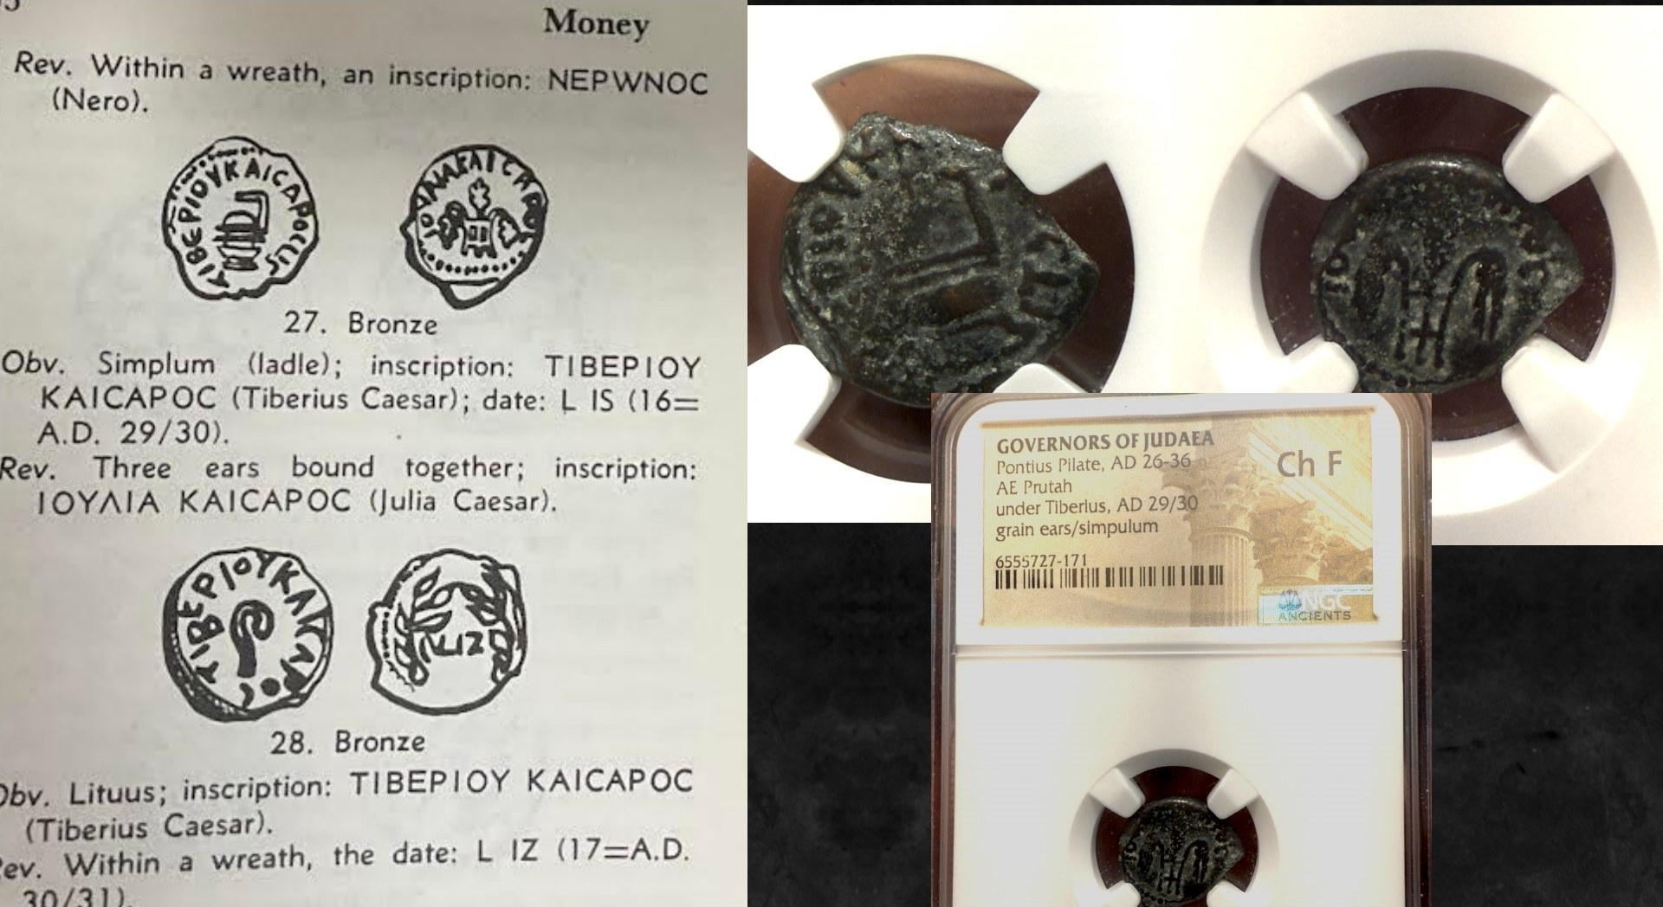
Coins struck under Pontius Pilate
Notes:
Bronze coins of Pontius Pilate, governor of Judaea AD 26–36, inscribed for Tiberius Caesar and Julia Caesar. Physical evidence for the governor named in the Gospels and by Tacitus.

Slide 59
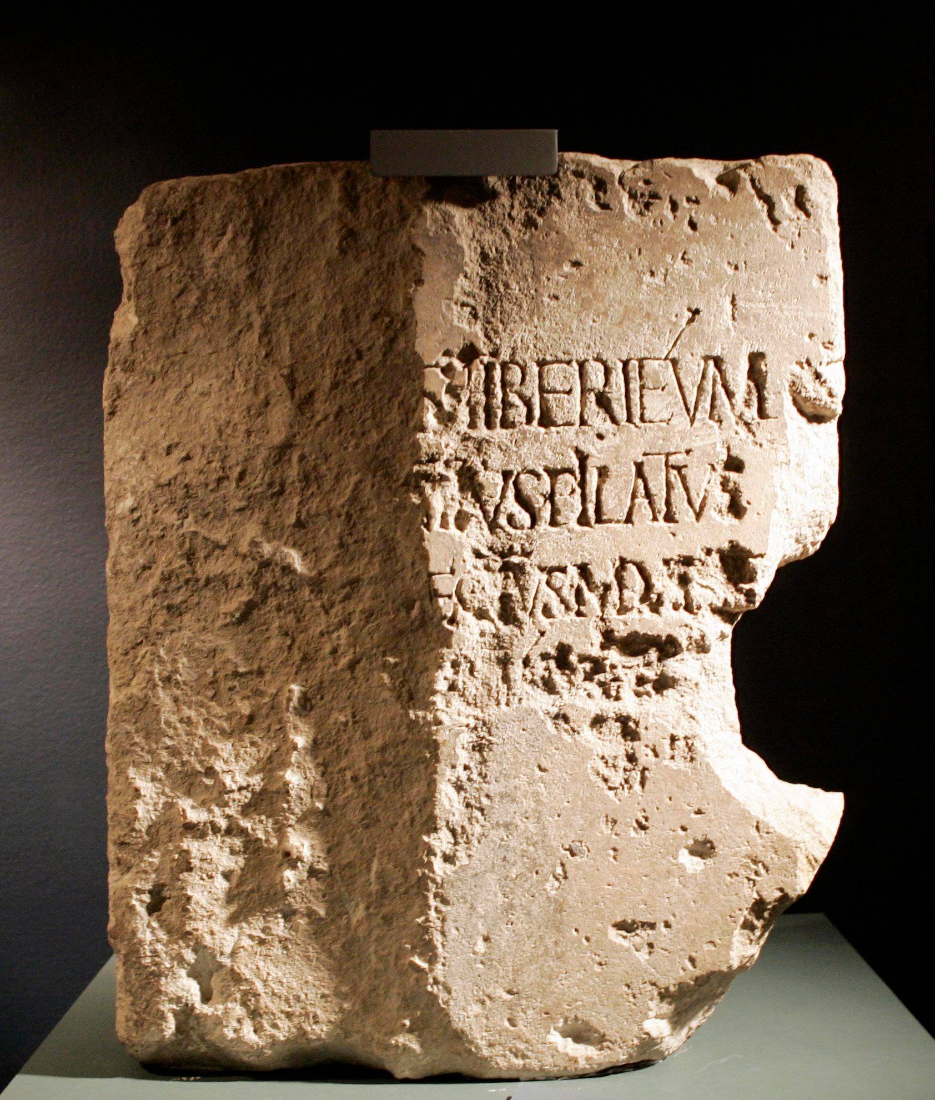
The Pilate Stone
Found 1961
At Caesarea Maritima, the Roman capital of Judea, where Pilate governed
The inscription
“[Pon]tius Pilatus … [Praef]ectus Iuda[ea]e”: Pontius Pilate, Prefect of Judea (AD 26–36)
Why it matters
The first inscription with Pilate’s name, carved in his lifetime. It confirms his title: prefect.
Where it is now
The Israel Museum, Jerusalem
Notes:
The Pilate Stone was found in June 1961 at Caesarea Maritima during excavations led by Antonio Frova. It is a limestone block, part of a dedication of a building (a Tiberieum, honouring the emperor Tiberius), naming Pontius Pilate as Prefect of Judea. Before its discovery, Pilate was known from the Gospels, Philo, Josephus and Tacitus; this is the first inscription bearing his name. Tacitus calls him procurator, but the stone shows his actual title was praefectus, the correct title for governors of Judea at that time. It is now in the Israel Museum, Jerusalem. Pilate governed Judea from about AD 26 to 36. All four Gospels and Tacitus (Annals 15.44) place Jesus' crucifixion under Pilate. Sources: Wikipedia, Pilate stone.

Slide 60
P52: the earliest Gospel fragment
DATE
THE FRAGMENT
2nd century
Credit-card size, from a codex (book)
Bought in Egypt, 1920; published 1935
John Rylands Library, Manchester
c. AD 100–150 by its first editor; some scholars now say up to c. 200
WHAT IT RECORDS: JOHN 18:31–33, 37–38
Jesus on trial before Pilate:
Pilate asks, “Are you the King of the Jews?” Jesus answers, “You say that I am a king. For this purpose I was born…” Pilate: “I find no guilt in him.”
Within decades of John being written, copies of Jesus’ trial before Pilate were already circulating in Egypt. The Pilate Stone confirms he governed Judea at the time.
Notes:
P52 (Papyrus Rylands Greek 457) is a fragment about 9 by 6 cm from a papyrus codex of John, acquired in Egypt by Bernard Grenfell in 1920 and published by Colin H. Roberts in 1935; it is held at the John Rylands Library, Manchester. Roberts dated it to the first half of the second century (about AD 100 to 150). Later scholars widen the range: Orsini and Clarysse (2012) AD 125 to 175; Brent Nongbri argues the later second or early third century is also possible; CSNTM lists it as second century. It is generally regarded as the earliest surviving fragment of any New Testament book, though P90, P104 and others may be close in date. The front (recto) has John 18:31 to 33: the Jewish leaders tell Pilate they are not permitted to put anyone to death, and Pilate asks Jesus, 'Are you the King of the Jews?' The back (verso) has John 18:37 to 38: 'You say that I am a king. For this purpose I was born and for this purpose I have come into the world, to bear witness to the truth', and Pilate's verdict, 'I find no guilt in him.' Only the first letter of Pilate's name survives on the fragment; the rest is restored from the full text. Significance: even the earliest scrap of the Gospels we possess records Jesus' trial before Pontius Pilate, the governor whom the Pilate Stone, Tacitus, Philo and Josephus confirm. Quotations from the ESV.

Slide 61
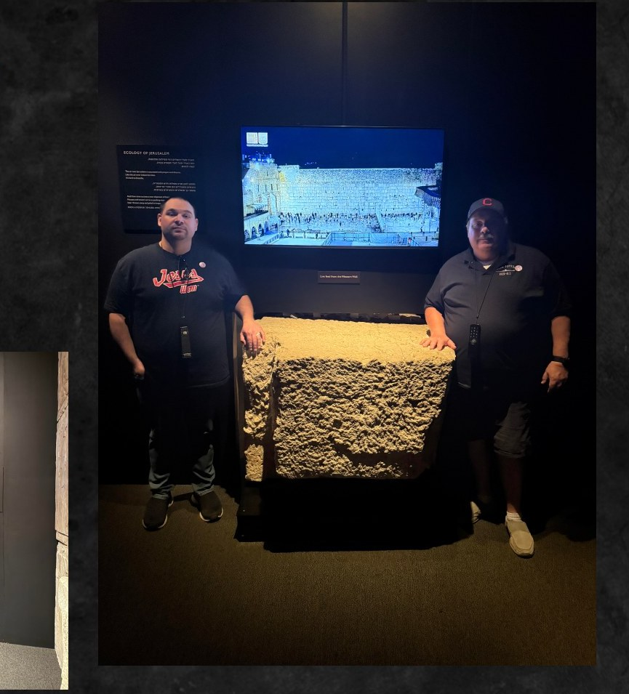
“Not one stone shall be left”
“Do you not see all these things? Assuredly, I say to you, not one stone shall be left here upon another, that shall not be thrown down.”
Matthew 24:2
This stone from the Temple Mount enclosure was likely thrown from the southwest corner during the brutal siege of AD 70.

Slide 62

Textual absolutism: the other ditch
Insisting that only one manuscript tradition, one translation or one translation method is the true Word of God.
One translation
One Greek text
One method
KJV-Onlyism: the 1611 King James is the only true English Bible
Textus Receptus only: Erasmus’s 1516 text, built from a handful of late manuscripts
Only word-for-word translations count, though every version translates for meaning
THE KJV TRANSLATORS THEMSELVES DISAGREED
“The very meanest translation of the Bible in English … containeth the word of God, nay, is the word of God.”
“The Translators to the Reader,” preface to the King James Version (1611)
“We have an embarrassment of riches in our English Bible translations.” Mark Ward, Authorized (2018) author, blog post 2015
Notes:
Textual absolutism is the second ditch from the 'Three ways to approach the text' slide: the opposite error to skepticism. Examples: (1) KJV-Onlyism, the view that the 1611 King James Version is the only true English Bible; in its extreme form (Peter Ruckman) the KJV is even said to correct the Greek. (2) Textus Receptus only: Erasmus's printed Greek New Testament of 1516 and its later editions are treated as the one pure text. Erasmus worked from a handful of late medieval manuscripts; for Revelation he had a single 12th-century manuscript missing its final leaf, so he translated the last verses back into Greek from the Latin Vulgate, producing some readings found in no Greek manuscript (Bruce Metzger and Bart Ehrman, The Text of the New Testament). (3) Translation-method absolutism: only formal-equivalence (word-for-word) versions are faithful; but Dave Brunn shows every version, the KJV included, gives priority to meaning over form in many places. Counterpoints: the KJV translators' own preface, 'The Translators to the Reader' (1611), says that even the very meanest (humblest) English translation set forth by men of their profession containeth the word of God, nay, is the word of God; the KJV was itself a revision of earlier English Bibles (Tyndale, Geneva, Bishops'); the 1611 edition included the Apocrypha, and the KJV most people read today is the 1769 Oxford revision. The Byzantine and critical texts agree in roughly 94% of the text, and no doctrine depends on a disputed reading. Mark Ward (Logos Bible Software; author of Authorized: The Use and Misuse of the King James Bible, Lexham Press, 2018) wrote: 'We have an embarrassment of riches in our English Bible translations' (blog post 'Our Embarrassment of Translational Riches', 24 March 2015). His book ends by urging readers to stop looking for the one best English Bible and take up the embarrassment of riches we now have, reading and comparing several good translations. Confidence rests on the whole manuscript record and faithful translations, not on one text or one version.

Slide 63
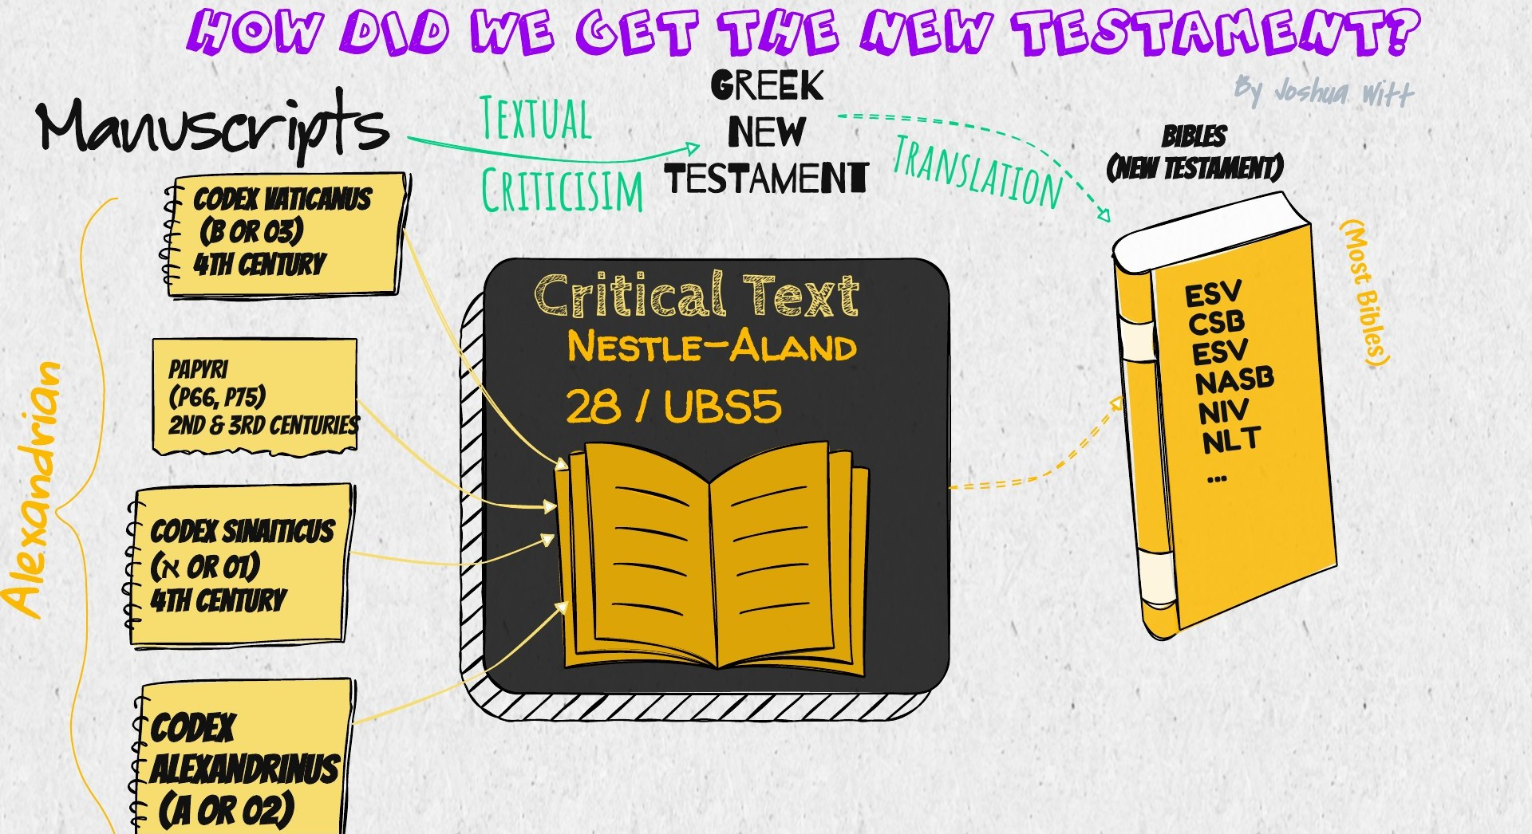
How did we get the New Testament?
Notes:
Alexandrian line: papyri (P66, P75, 2nd–3rd centuries), Codex Vaticanus (B/03, 4th c.), Codex Sinaiticus (Aleph/01, 4th c.), Codex Alexandrinus (A/02). Textual criticism produces the Greek critical text (Nestle-Aland 28 / UBS5), which is translated into most modern Bibles: ESV, CSB, NASB, NIV, NLT.

Slide 64
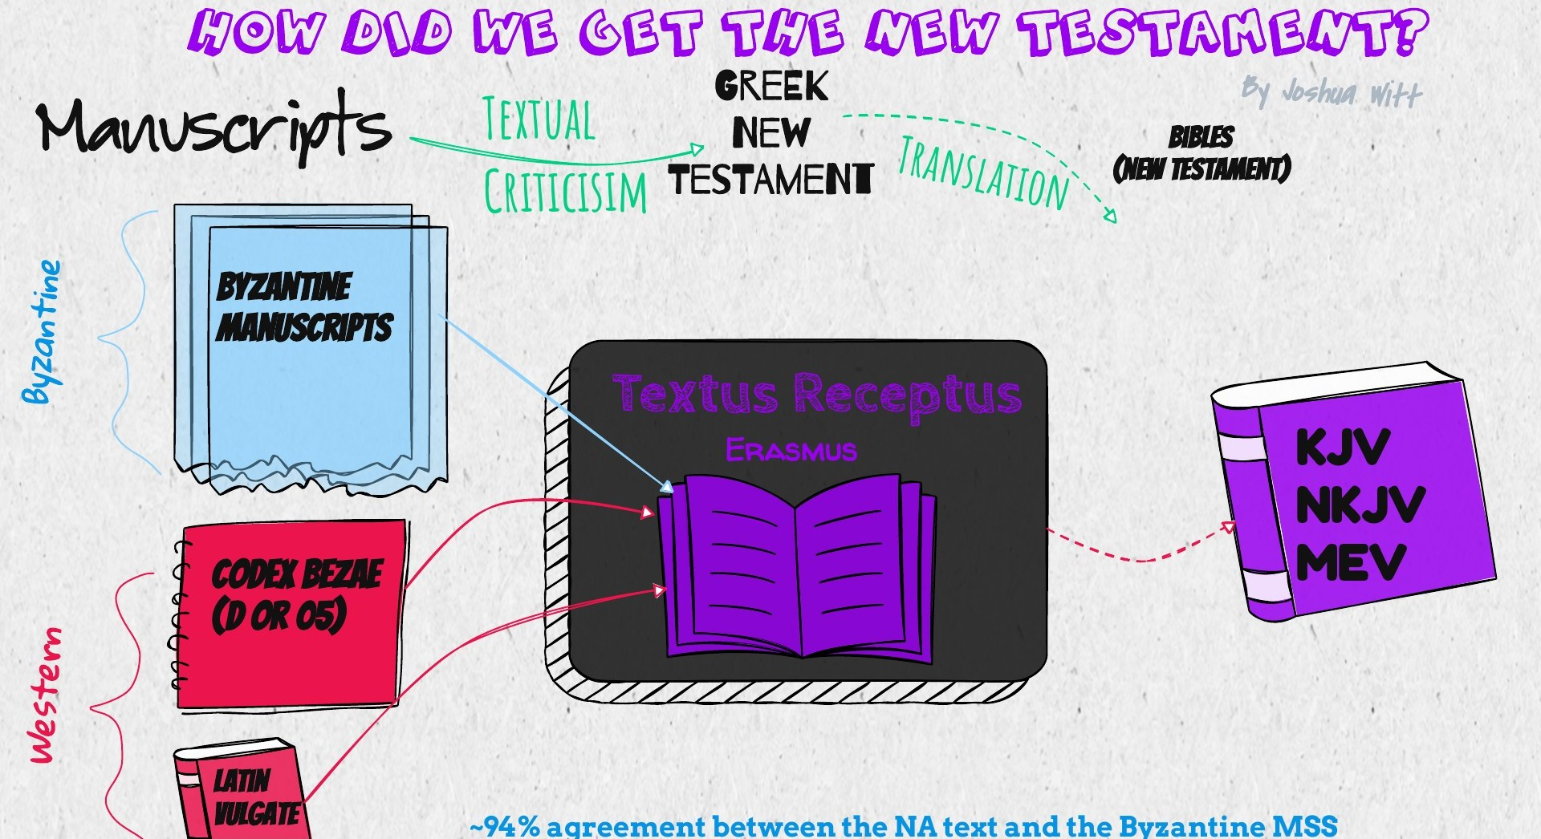
The Byzantine and Western lines
~94% agreement between the Nestle-Aland text and the Byzantine manuscripts
Notes:
Byzantine manuscripts lead to Erasmus' Textus Receptus, the basis of the KJV, NKJV and MEV. The Western line includes Codex Bezae (D/05) and the Latin Vulgate.

Slide 65
Translation carries meaning, not just words
GERMAN
WORD FOR WORD
MEANING
Wie viel Uhr ist es?
How much clock is it?
What time is it?
Uhr (clock) is “removed” and time is “added”, yet nothing is lost: that is the only accurate translation. Word for word would be wrong. Translation is about meaning, and it is complex.
“Every version gives priority to meaning over form.”
“Every version uses interpretation when translating ambiguities.”
Dave Brunn, One Bible, Many Versions: Are All Translations Created Equal? (IVP, 2013), pp. 189–90
Notes:
The German example: Wie viel Uhr ist es? literally reads How much clock is it? The faithful English translation, What time is it?, drops the word Uhr (clock) and supplies the word time, which is not in the German at all. Someone counting words could complain that a word was removed and another added, but the word-for-word version is the one that is actually wrong, because it fails to convey the meaning. That is why every Bible translation has to choose words for meaning, and why translation is more complex than swapping word for word. Dave Brunn, a Bible translator with New Tribes Mission (Ethnos360) who translated the New Testament into the Lamogai language of Papua New Guinea, compared major English versions (KJV, NASB, ESV, NIV, NLT and others) verse by verse. His summary of conclusions (pp. 189 to 90) includes: every version gives priority to meaning over form; every version gives priority to the meaning of idioms and figures of speech over the actual words; every version steps away from the form to avoid wrong meaning or zero meaning; every version uses interpretation when translating ambiguities; and every version adds interpretation, even when it is not absolutely necessary. His point: there is no such thing as translation without interpretation, so the question is not whether a version interprets, but how faithfully it conveys the meaning. Quotations as reproduced by Kenneth Berding (Biola University, Good Book Blog, 2013) and Andy Naselli (2013).

Slide 66
Same story, different words
The Synoptic Gospels (Matthew, Mark, Luke) often tell the same event in different words. Mounce explains why:
Translation
“GET UP, TAKE YOUR MAT AND GO HOME”
Jesus spoke Aramaic; the Gospels are written in Greek
Gospel | “Mat” | “Go”
Matthew 9:6 | klinē: a bed or couch | hypage
Mark 2:11 | krabattos: a mattress, a poor person’s bed | hypage
Luke 5:24 | klinidion: a small bed, like a stretcher | poreuou
Simplification
Writers summarized and compressed long accounts
Paraphrase
The very voice of Jesus, not always his very words
Approximation
Different words, the same meaning: all three are rightly translated “take your mat and go home.”
Round numbers and general descriptions
William D. Mounce, Why I Trust the Bible (Zondervan, 2021), on the Synoptic Problem
Notes:
Based on William D. Mounce, Why I Trust the Bible (Zondervan, 2021), his discussion of the Synoptic Problem and apparent contradictions. 'Synoptic' means 'seen together': Matthew, Mark and Luke share many of the same stories. Mounce says ancient writers were quite comfortable with simplification, paraphrase and approximation; if we allow the Gospel writers to do what other writers do (translate, summarize, compress and paraphrase) there are no insurmountable problems. He distinguishes the ipsissima verba (Jesus' very words) from the ipsissima vox (his very voice): since Jesus mostly spoke Aramaic and the Gospels are in Greek, in most cases we have his voice, faithfully conveyed. His example is the healing of the paralyzed man (Matt 9:6, Mark 2:11, Luke 5:24). Matthew uses klinē (a bed or couch), Mark krabattos (a mattress or pallet, a poor person's bed), Luke klinidion (a small bed, like a stretcher), and Luke says poreuou where Matthew and Mark say hypage for 'go'. The words are different, but they mean the same basic thing, and English versions translate all three the same way.

Slide 67
By the numbers
5,800+
1,000×
< 1%
Greek manuscripts of the New Testament
more manuscript data than the average classical author
of 400,000 variants both change the meaning and could be original
1 million+
1,000 yrs
Decades
New Testament quotations in the church fathers
older: Dead Sea Isaiah scrolls, over 95% word for word the same
from John’s Gospel to its earliest copy, P52; 500+ years for classical authors
≈ 5 yrs
500+
4,190
from the crucifixion to the creed Paul records in 1 Corinthians 15
witnesses to the risen Jesus, most still alive when Paul wrote
languages with at least some Scripture
Treated like any other historical book, it is neither a fairy tale nor just another book.
Notes:
A recap of the strongest numbers in the talk, with where each came from. 5,800+ Greek manuscripts and 1 million+ patristic quotations: Daniel Wallace, interview with Justin Taylor (2012). 1,000 times the manuscript data: same interview. Under 1% of variants meaningful and viable: Wallace, JETS 49/2 (2006), p. 330. Dead Sea Isaiah scrolls a thousand years older and over 95% identical: Gleason Archer, A Survey of Old Testament Introduction (1964), p. 19. P52, 2nd century, within decades of John (about AD 90); classical authors' earliest copies at least 500 years later: Wallace (2012). The creed in 1 Corinthians 15:3 to 7, which scholars date to within a few years of the crucifixion. Over 500 witnesses: 1 Corinthians 15:6. 4,190 languages: SIL ProgressBible (October 2026).

